Slide 1
Floral Tools

Slide 2
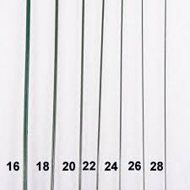
#18 #24 #28 Florist’s Wire

Slide 3
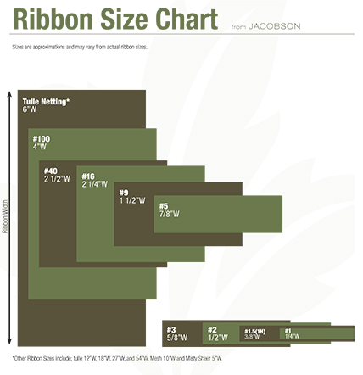
#3 #9 #40 Ribbon

Slide 4
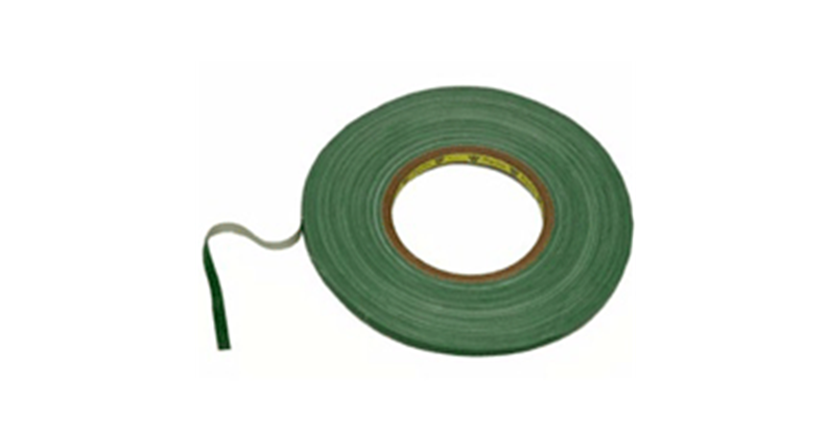
Anchor Tape

Slide 5
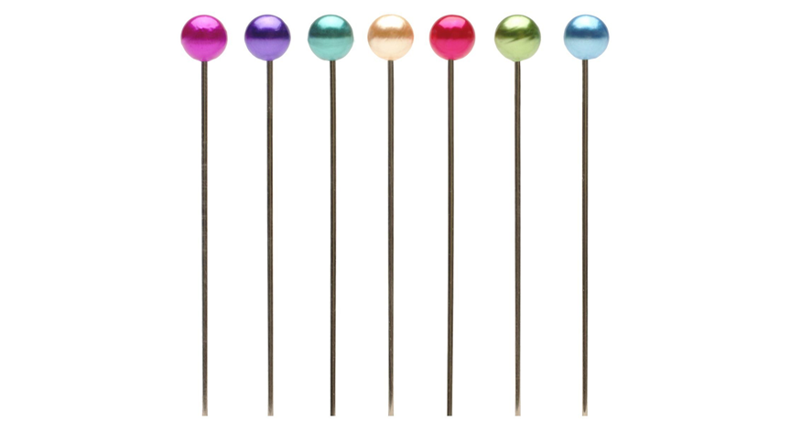
Boutonniere Pin

Slide 6
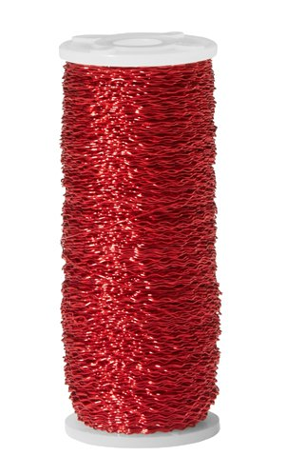
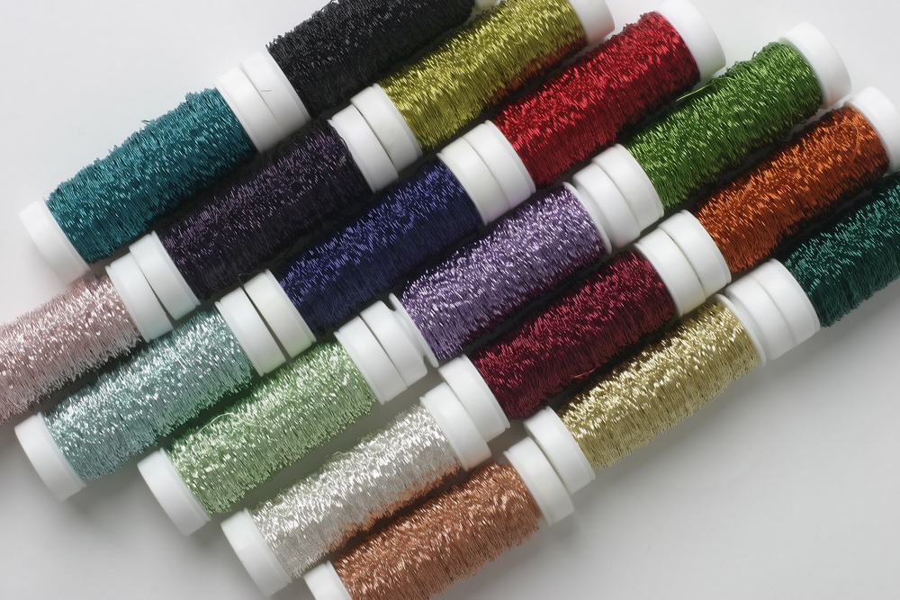
Bullion Wire

Slide 7
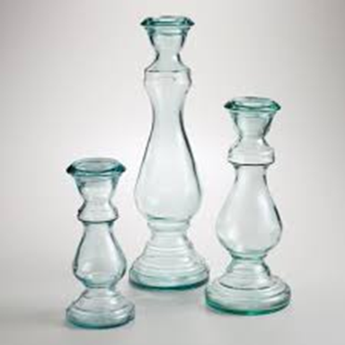
Candle Pick/Holder

Slide 8
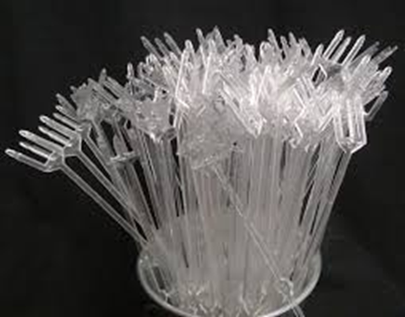
Cardette/Card Holder

Slide 9
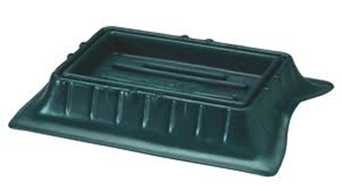
Casket Saddle

Slide 10
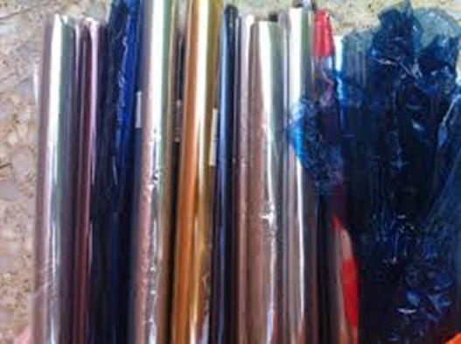
Cellophane

Slide 11
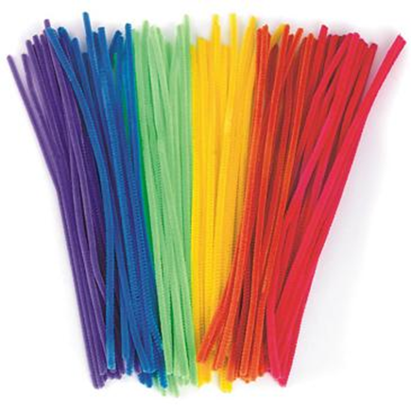
Chenille Stem

Slide 12
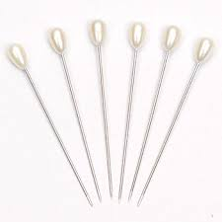
Corsage Pin

Slide 13
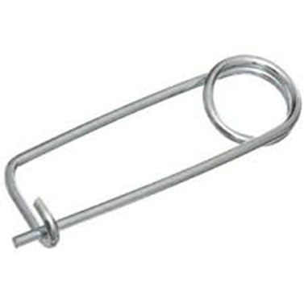
Dixon Pin

Slide 14
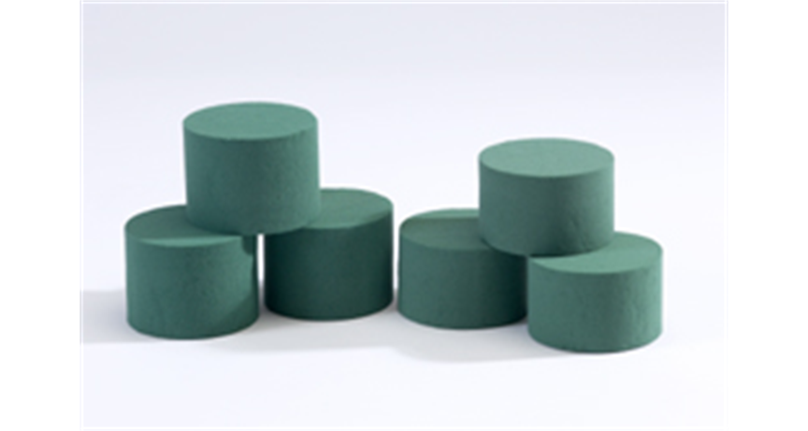
Dry Foam

Slide 15
Enclosure Card

Slide 16
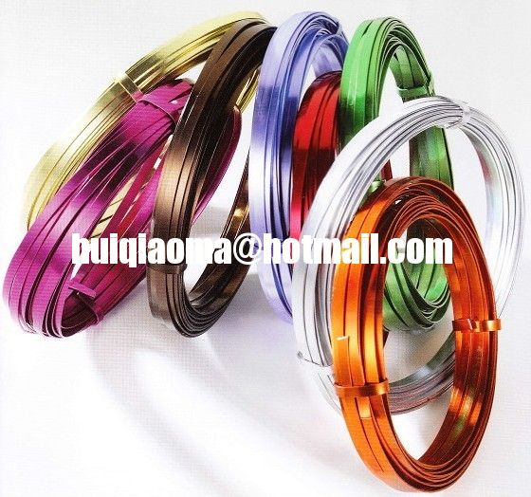
Flat Aluminum Decorative Wire

Slide 17
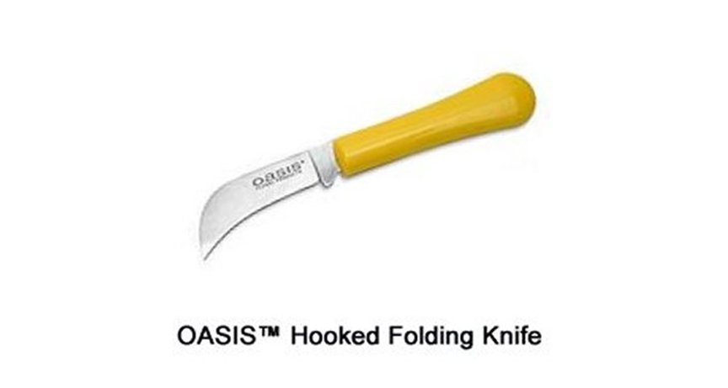
Floral Knife

Slide 18
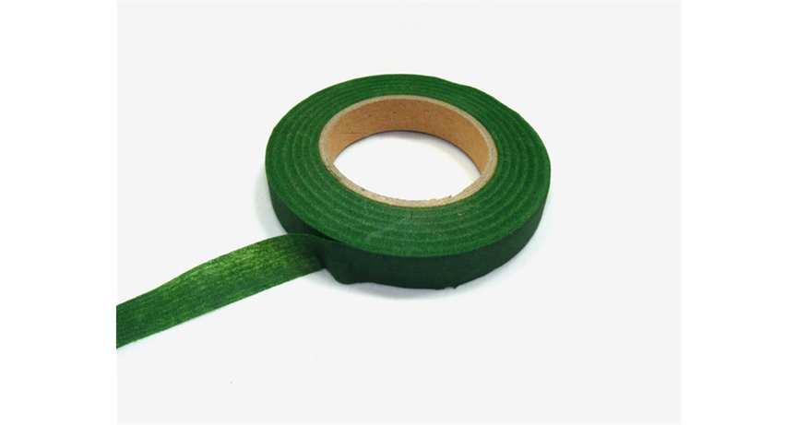
Floral Tape

Slide 19
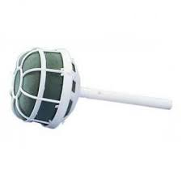
Foam Bouquet Holder

Slide 20
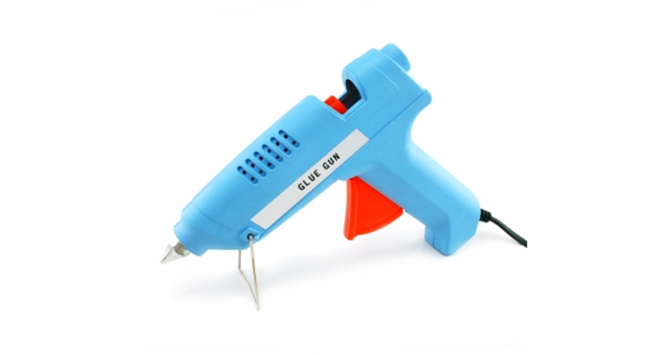
Glue Gun

Slide 21
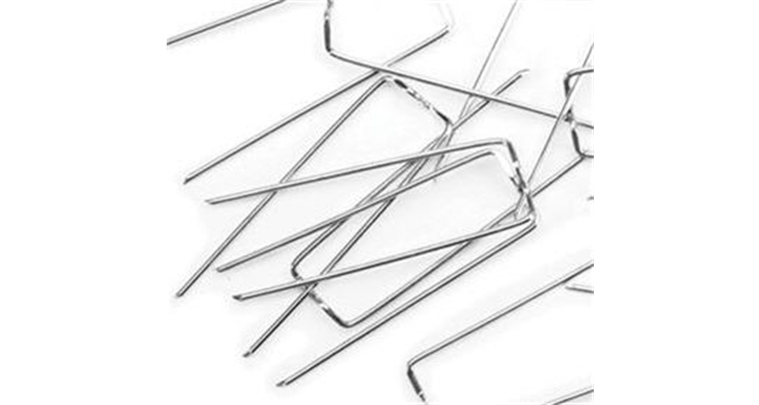
Greening Pins

Slide 22
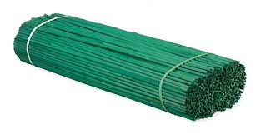
Hyacinth Stake

Slide 23
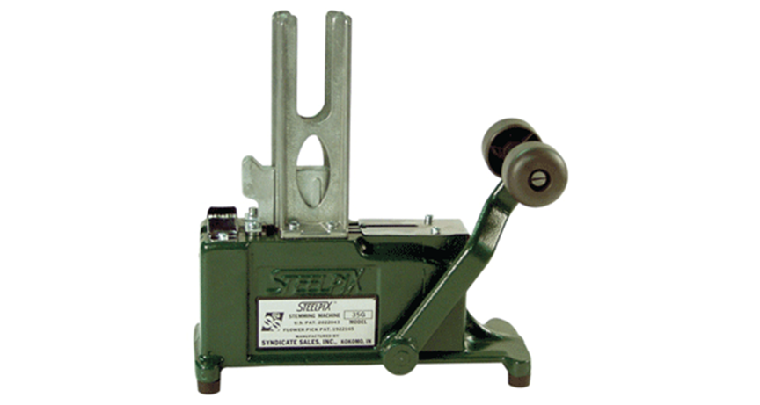
Pick Machine & Metal Picks

Slide 24
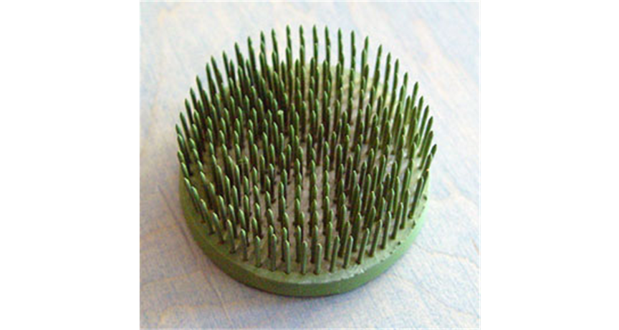
Pin Holder (Frog)

Slide 25
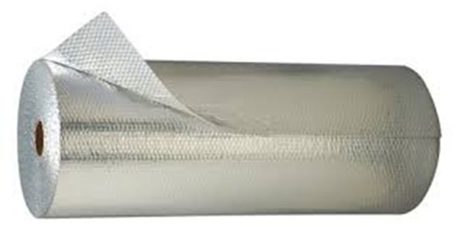
Polyfoil

Slide 26
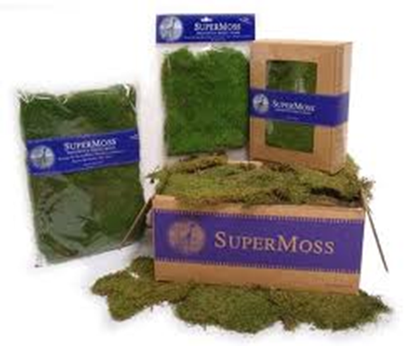
Sheet Moss

Slide 27
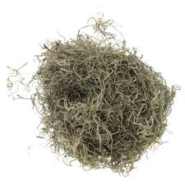
Spanish Moss

Slide 28
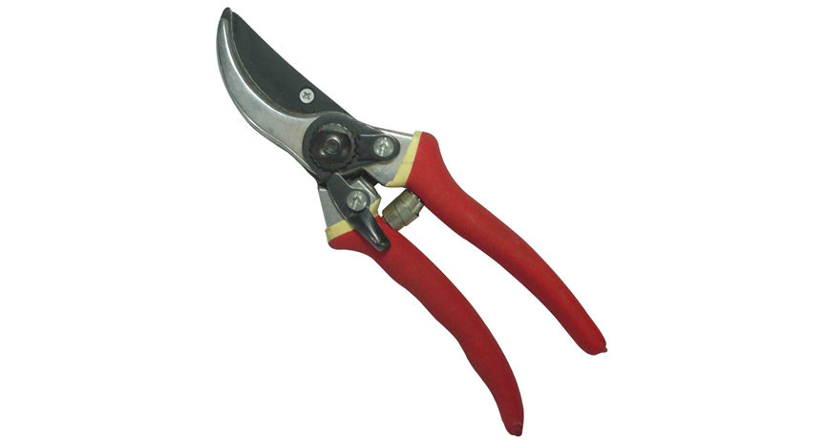
Stem Cutter

Slide 29
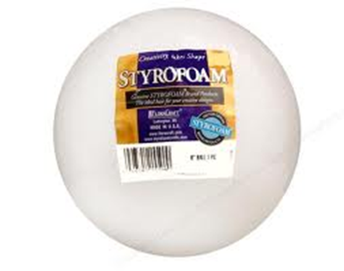
Styrofoam

Slide 30
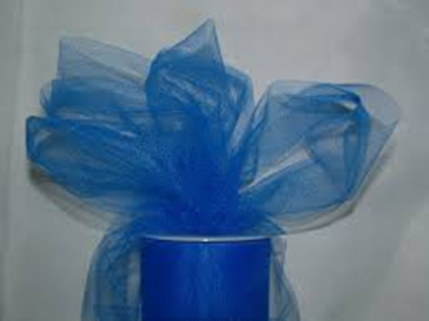
Tulle

Slide 31
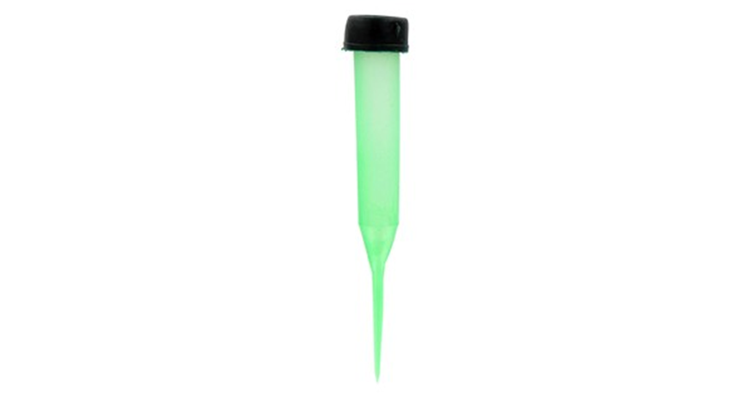
Water Picks

Slide 32
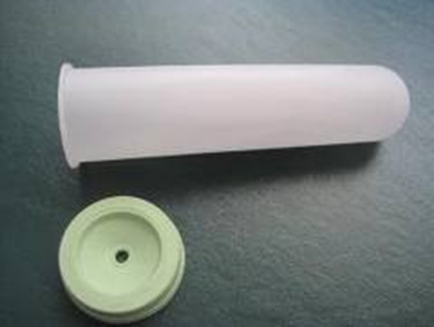
Water Tubes

Slide 33
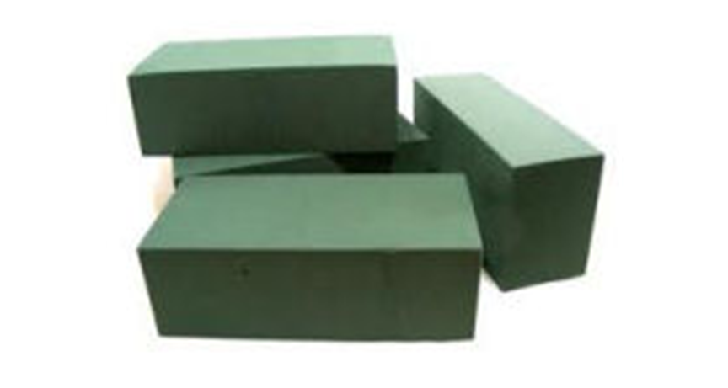
Wet Floral Foam(Oasis)

Slide 34
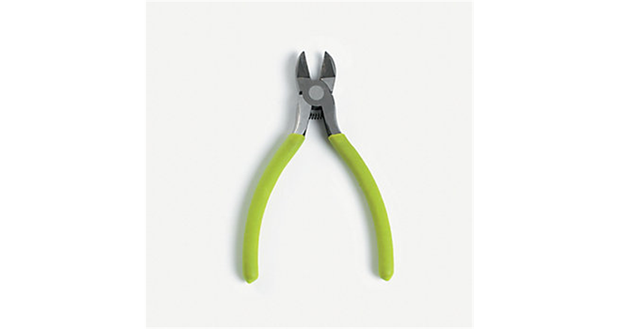
Wire Cutter

Slide 35
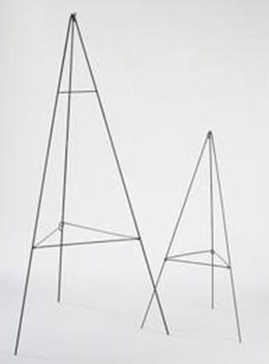
Wire Easel

Slide 36
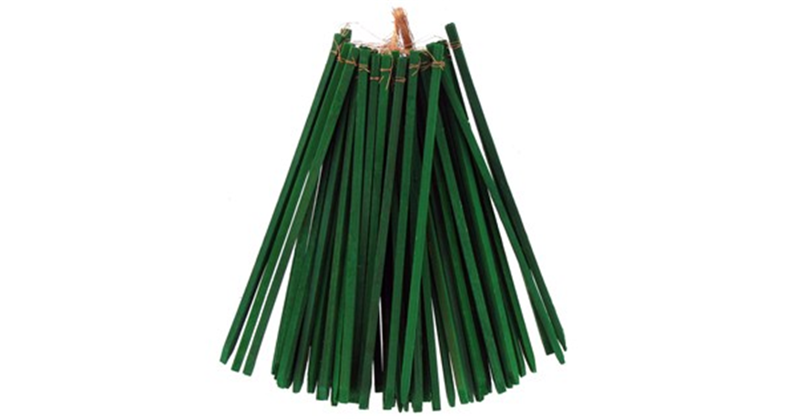
Wooden Pick

Slide 37
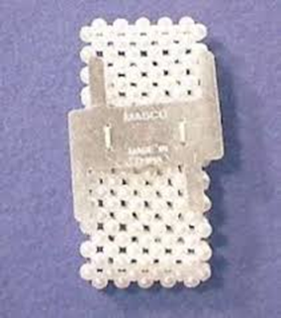
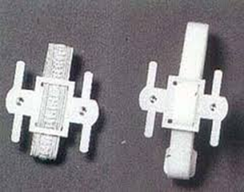
Wrist Corsage Holder

