Slide 1
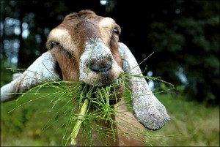
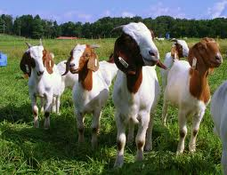
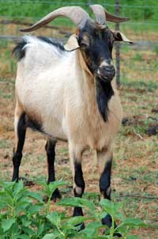
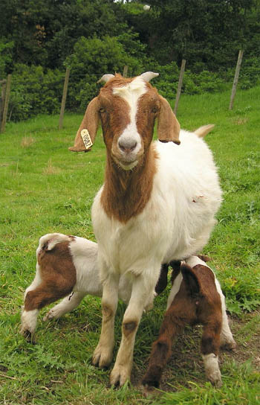
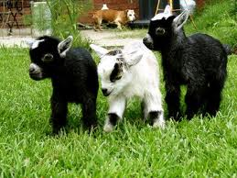
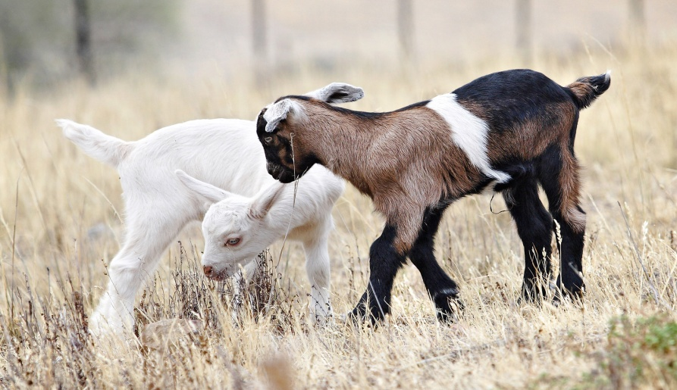
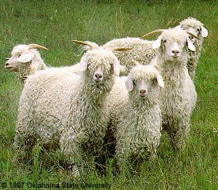
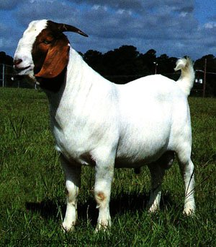
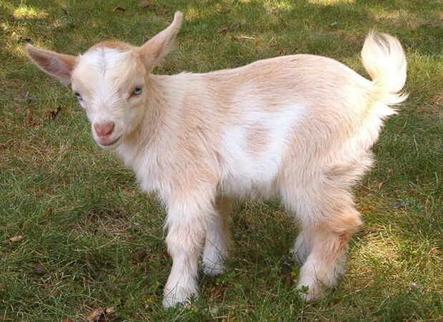
Goat Breeds

Slide 2
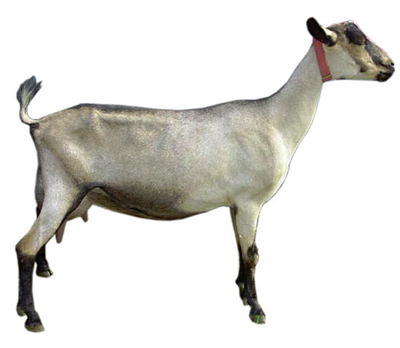
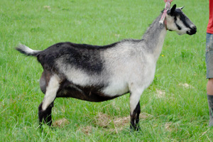
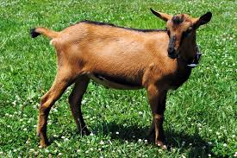
Alpine

Slide 3
Angora
Originated in Turkey
Produces mohair
Over 90% of the nation’s Angora goats reside in Texas, primarily in the Edward’s Plateau.

Slide 4
South African Boer
Originated in Africa
Medium sized with prominent horns and broad, drooping ears
Brown head and neck with white body
Valued for meat production

Slide 5
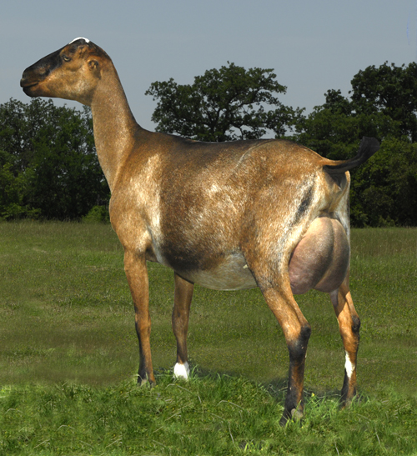
LaMancha
Developed in the United States in the 1950’s
Recognized by their very short ear (maximum of 1 inch)
Any color or pattern
Dairy goat

Slide 6
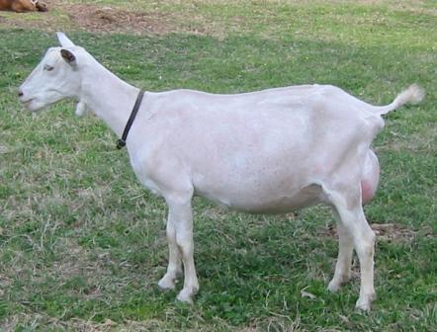
Saanen
Originated in Switzerland
Large size with erect ears
White or light cream
Heaviest milking breed

Slide 7
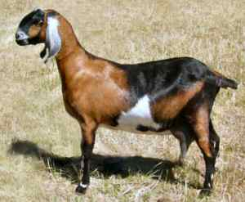
Nubian
Developed in Great Britain from African and Middle Eastern breeds
Large goat with large pendulous ears and a roman nose
Any color or color pattern
Well-suited to hot climates
Dual purpose breed

Slide 8
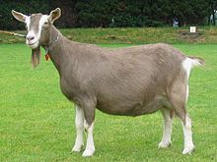
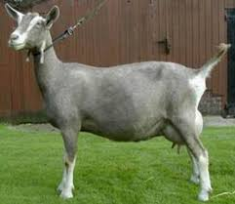
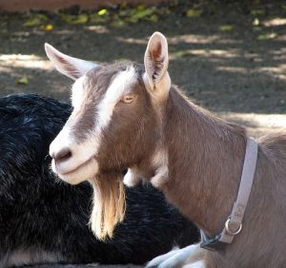
Toggenburg

Slide 9
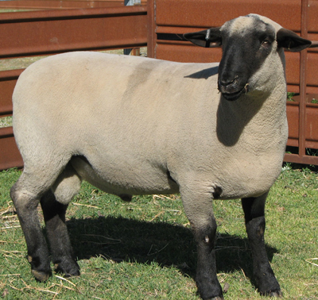
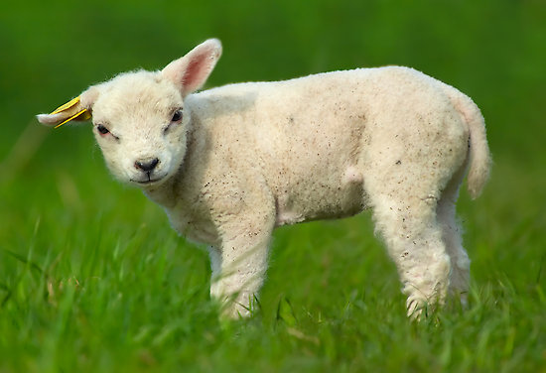
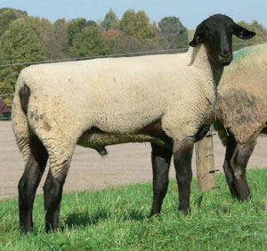
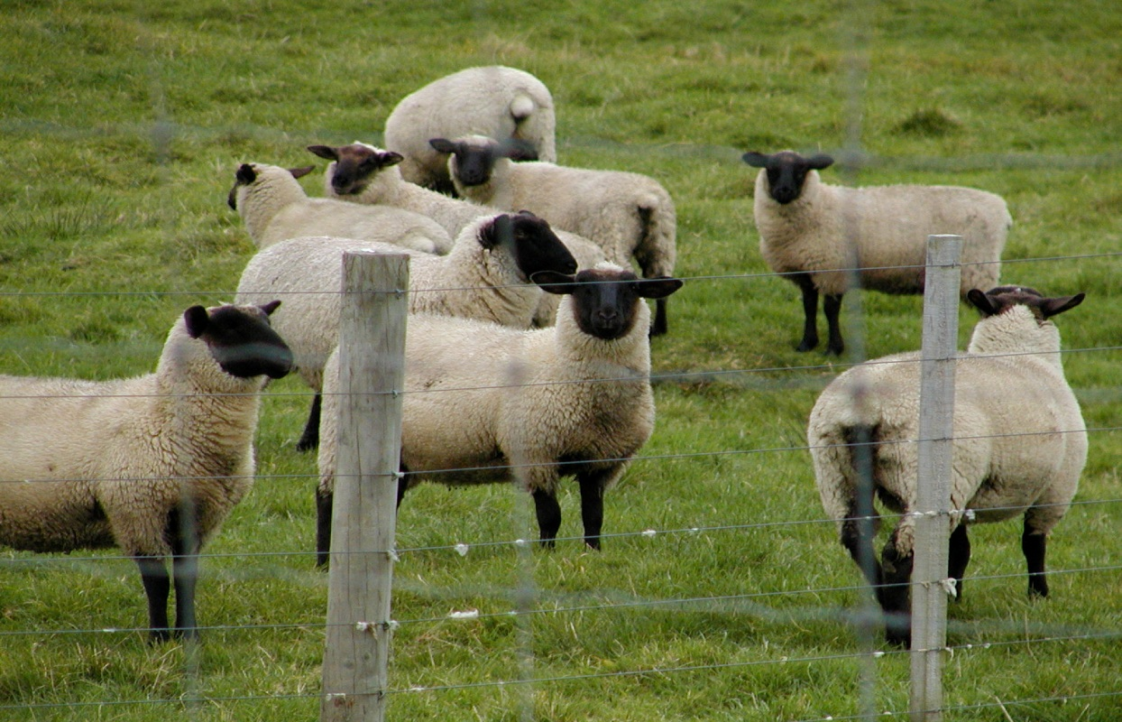
Sheep Breeds

Slide 10
Columbia
Developed in the United States
Foundation of Lincoln rams on Rambouillet ewes
Largest of the crossbred breeds
White faced, polled breed

Slide 11
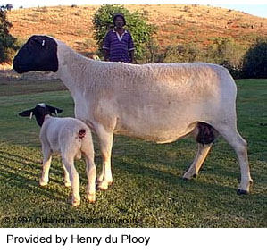
Dorper
From South Africa
Thick skin that is made up of hair and wool
Extremely adaptable with a high ability to flourish, grow and produce and reproduce in irregular and low rainfall events

Slide 12
Dorset
Originated in England
Horned and polled strains
Ability to breed out of season
White-faced sheep that produce a light shearing, open fleece

Slide 13
Hampshire
Originated in England
Rapid growth and muscularity
Dark brown to black face and legs with a wool cap on head

Slide 14
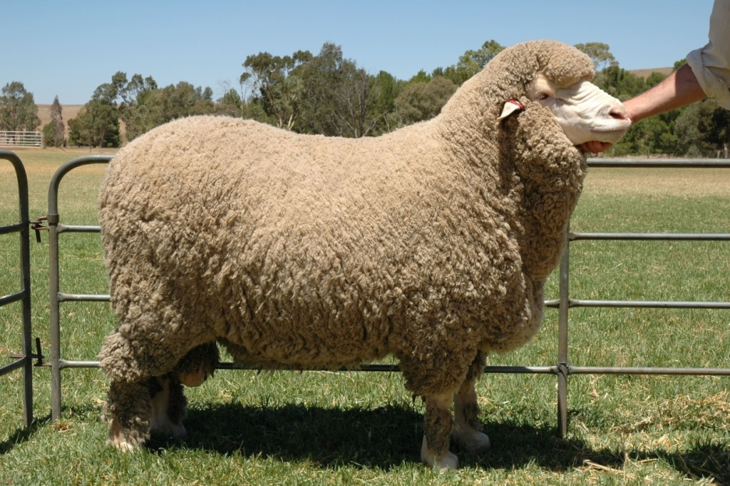
Merino
Originated in Spain
Most dominant breed in the worldwide sheep industry
Typically smaller than other wool breeds
White faced breed

Slide 15
Rambouillet
Originated in France
Dominant range ewe in the western United States
White-faced breed that is not extremely prolific under range conditions

Slide 16
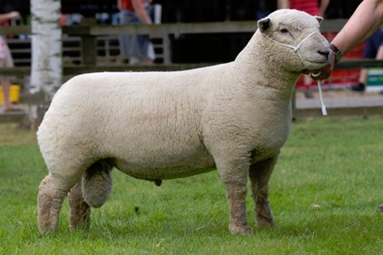
Southdown
Originated in England
One of the oldest sheep breeds
Medium to small sized with light brown face and legs
Produce meaty, light weight carcasses
Low maintenance breed

Slide 17
Suffolk
Originated in England
Black head and legs which are free of wool
Alert, active sheep that grow very fast and produce lean, muscular carcasses

