Slide 1
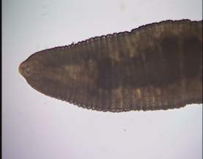
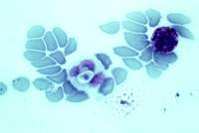
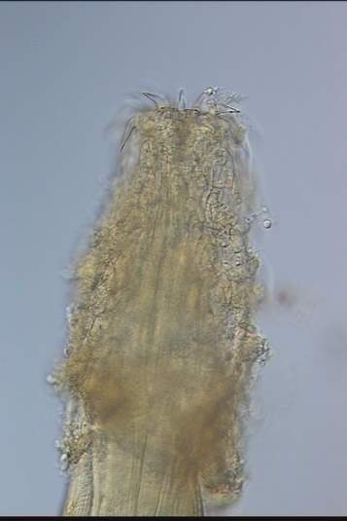
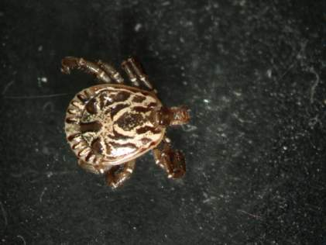
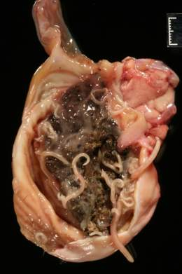
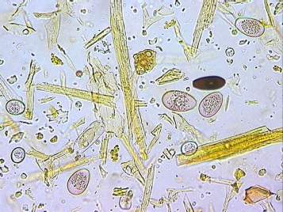
Parasites critters in or critters

Slide 2
Parasites, so what?
Dr. Tom Craig
Department Veterinary Pathobiology
Texas A&M University

Slide 3
Who are parasites? Eukaryotic organisms that live in or on a host and may cause disease
Arthropods: ticks, mites, flies, fleas, lice
Helminths: nematodes (cylindrical or round worms), cestodes (tapeworms), trematodes (flukes)
Protozoa: amoeba, flagellates, ciliates, apicomplexa
Lets find out about them

Slide 4
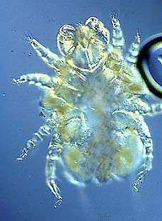
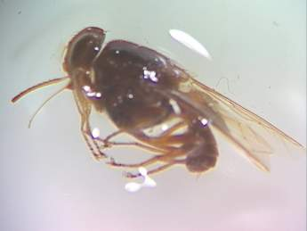
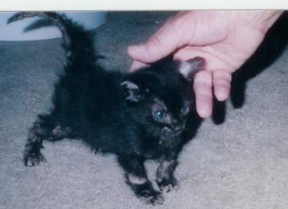
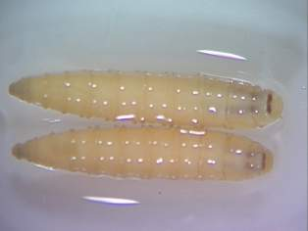
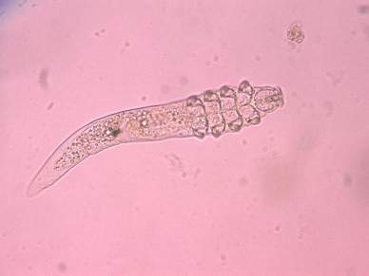
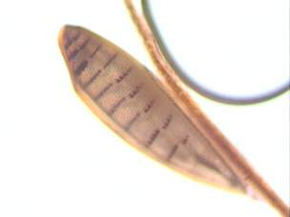
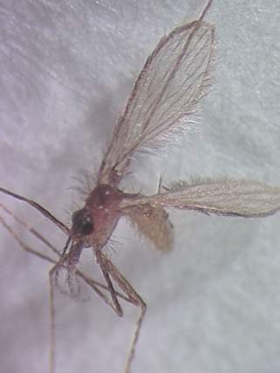
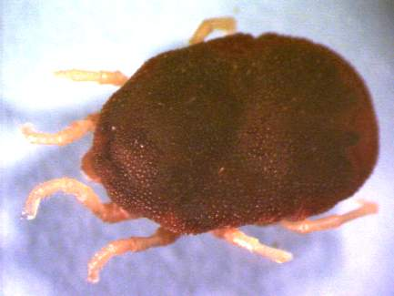
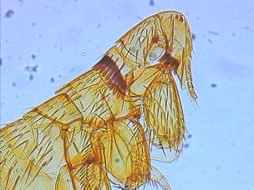
Arthropods

Slide 5
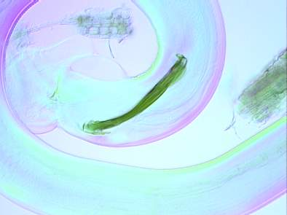
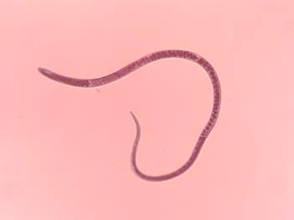
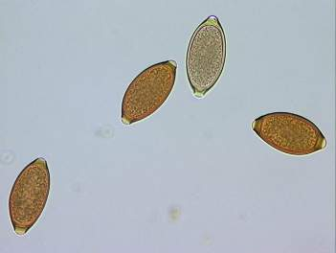
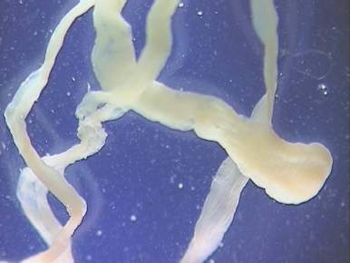
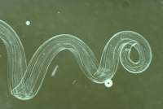
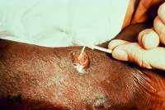
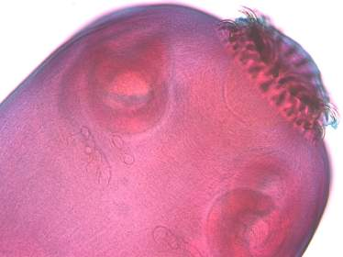
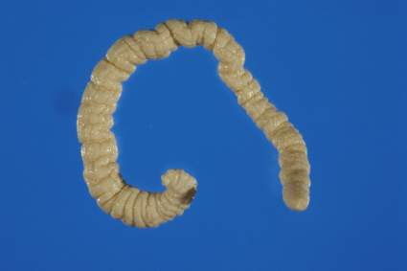
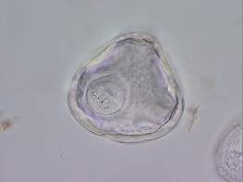
Helminths

Slide 6
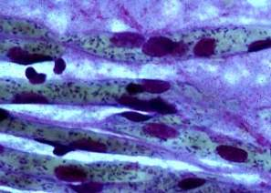
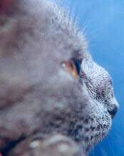
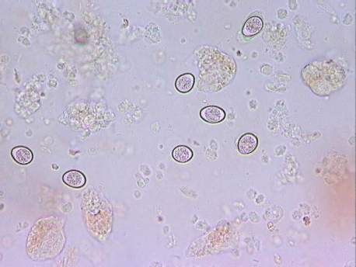
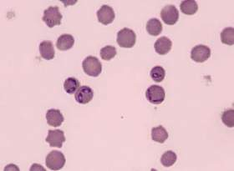
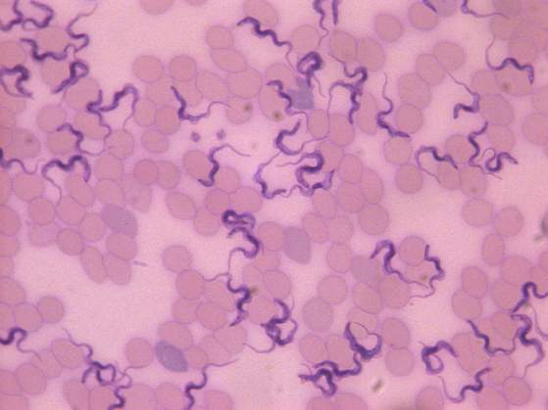
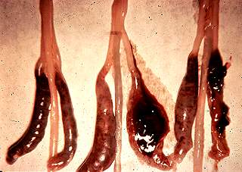
Protozoa

Slide 7
Parasites live on or in a host
A host is a animal that provides a living for a parasite: the host could be a pig, a person or poultry
Parasites are specific : which species of host, where in or on the body they live, how they make a living, what kind of damage they do
Hosts may tolerate parasites, become resistant to, co-exist with, or suffer from and even die because of them
Infection with parasites does not mean disease!
Disease occurs with excessive numbers of parasites
The numbers required to cause disease varies with host, parasite, and environment

Slide 8
Life cycles : the essence of parasitology
The steps from one generation to the next:
Where?
What do they look like?
What do they do? How they make a living and what happens to the host
How do they survive? Inside and away from the host
What can we do to prevent disease?

Slide 9
How do we know if there are parasites present
Look for parasites:
Ectoparasites may be readily seen or you may have to scrape the skin
Internal parasites release their reproductive products into the blood, urine or feces; Microscopic evaluation after separation of parasitic reproductive products from host
Postmortem examination looking in specific tissues for presence of parasites
Evidence of past or present infection:
Looking for antibodies, changes in serum chemistry, parasite secretions

Slide 10
For diagnosis of parasites you need to answer three things
1. Host: What is the species, sex and age of host
2. Parasite: Are we looking for something grossly visible or microscopic , where do we look? Organ, tissue or what comes from them
3. Environment: Where does the host live and make a living? Climate, time of year, food intake, where they rest, who else lives there

Slide 11
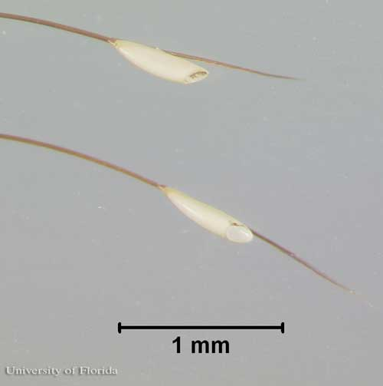
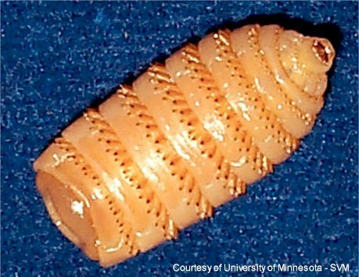
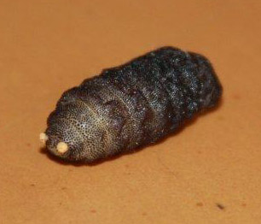
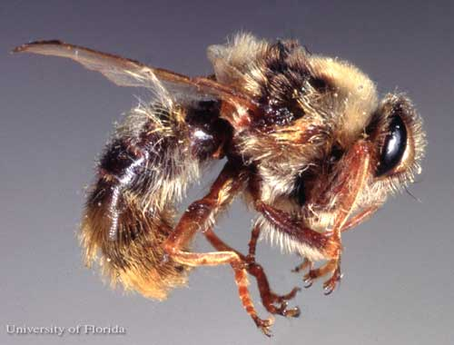
Gasterophilus hemorrhoidalis- bot fly of horse
Egg
Larvae
Pupae
Adult

Slide 12
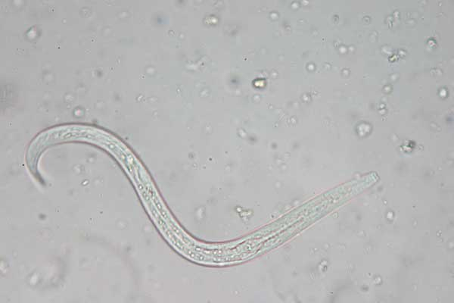
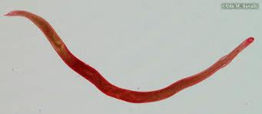
Ancylostoma caninum-Hookworm
Egg
Larvae
Adult

Slide 13
Ancylostoma braziliense-hookworm
Egg
Adult
Larvae

Slide 14
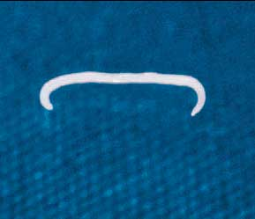
Ancylostoma tubaeforme-hookworm
Egg
Larvae
Adult

Slide 15
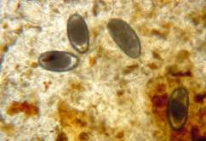
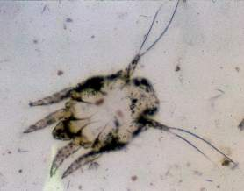
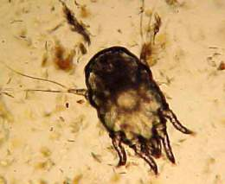
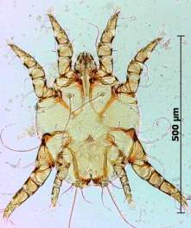
Otodectes - ear mite
Eggs
Larva
Nymph
Found on the surface of the cat ear canal
Adult

Slide 16
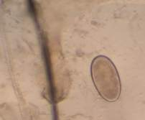
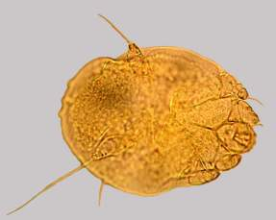
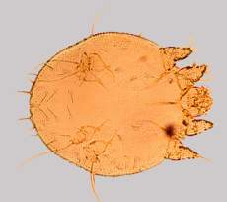
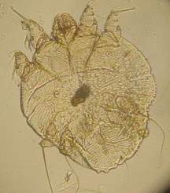
Sarcoptes scabei - mite
Egg
Nymph
Larva
Found in the skin of many animal species
(dogs, pigs, people)
Adult

Slide 17
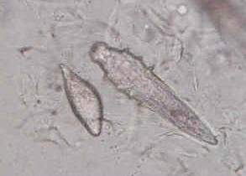
demodex canis - mite
Egg
Larvae
Egg
Larva
Adult
Found in hair follicles of dogs

Slide 18
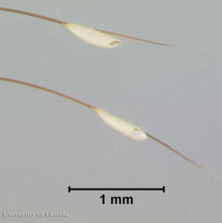
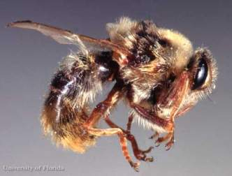
Gasterophilus intestinalis- bot fly of horse
Larva
Horse Tongue and Stomach
Egg
Horse hair
Pupa
Pasture Soil
Adult female
Near horses

Slide 19
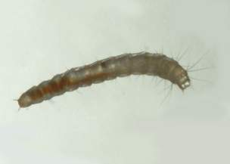
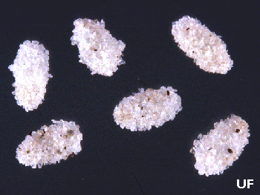
Ctenocephalides felis- cat flea
Eggs
Hair of cat or dog
Larva
Floor cracks, rugs, carpets and animal bedding
Pupae
Silk cocoons
Adult
Hair of dog or cat

Slide 20
Anoplura – sucking lice
Egg
Hair of swine, cattle or others
Nymph
Skin of swine or cattle
Adult
Skin of swine or cattle

Slide 21
Mallophaga - chewing lice
Nymph
Adult
Egg
on feathers of birds (primarily) or hair of mammals

Slide 22
Strongylus vulgaris – large strongyle of the horse
Eggs
Feces of horse
Larvae Found in soil, are ingested go to the intestine crawl out of intestine
travel to the blood vessels develop for months then return to intestine as adults
Adult
cecum and colon of horse

Slide 23
Strongyloides westeri intestinal threadworms of horse
Egg-adult female lives in small intestines of foals Larvated eggs passed in feces
Larva
Skin penetration, or passed in milk to young foals
Adult female
Small intestine of foals

Slide 24
Dirofilaria immitis-heartworm of dogs
Larva
Mosquito
Microfilaria
Blood
Adults
Heart

Slide 25
Toxocara canis- round worm of dogs
Egg
Soil contaminated with feces
Egg containing larva eaten by dog
Larva
Egg hatches canine intestinal tract
Larva goes to lungs, then tissues uterus if the dog is pregnant, or mammary glands if host recently whelped
Adults
Canine intestine where they mate.

Slide 26
Trichuris vulpis- whipworm
Egg
Ingested by dog and hatch in small intestine
Larva
Penetrate into the intestinal wall of dog, then re-enter the lumen after 2-10 days, then passes down to the dog’s cecum
Adult
Mucosa of cecum and large intestine in dog

Slide 27
Dipylidium caninum- tapeworm dog and cat
Egg ingested
by larvae flea
Egg basket
Dog/Cat feces
Adult
Dog/cat small intestine

Slide 28
Taenia pisiformis- dog tapeworm
Proglottids
When the dog eats the rabbit they begin to form in the small intestine
Eggs
Eliminated in feces and ingested by a rabbit and hatches in small intestine
Larvae
Burrows through the intestinal wall and travels to the liver via the blood

Slide 29
Fasciola hepatica - liver fluke of cattle and sheep
Egg
Feces
Cercariae
Snail
Miracidium
Adult
Liver
Metacercariae
Vegetation

Slide 30
Giardia intestinalis
Cyst
Trophozite
Found in feces of many animal species

Slide 31
Giardia troph

Slide 32
Calcium oxalate crystals

Slide 33
Cat Warble (Genus Cuterebra)

Slide 34
Cocci (Bacteria)

Slide 35
Coccidia (Genus Isopora or Eimeria)

Slide 36
Eosinophils

Slide 37
Epithelial cells (urine)

Slide 38
Flea Larva (Genus Ctenocephalides)

Slide 39
Flea Tapeworm Egg (Genus Dipylidium)

Slide 40
Flea Tapeworm Segment (Genus Dipylidium)

Slide 41
Flea Tapeworm (Genus Dipylidium)

Slide 42
Fleas (Genus Ctenocephalides)

Slide 43
Mosquito Adult & Larva

Slide 44
Neutrophils

Slide 45
Platelets

Slide 46
Red blood cell (erythrocyte)

Slide 47
Rod (bacteria)

Slide 48
Tick – American Dog

Slide 49
Tick – Black Legged Deer

Slide 50
Tick – Brown Dog

Slide 51
Tick - Lonestar

Slide 52
Yeast (cytology)

