Slide 1
Instruments Part 2

Slide 2
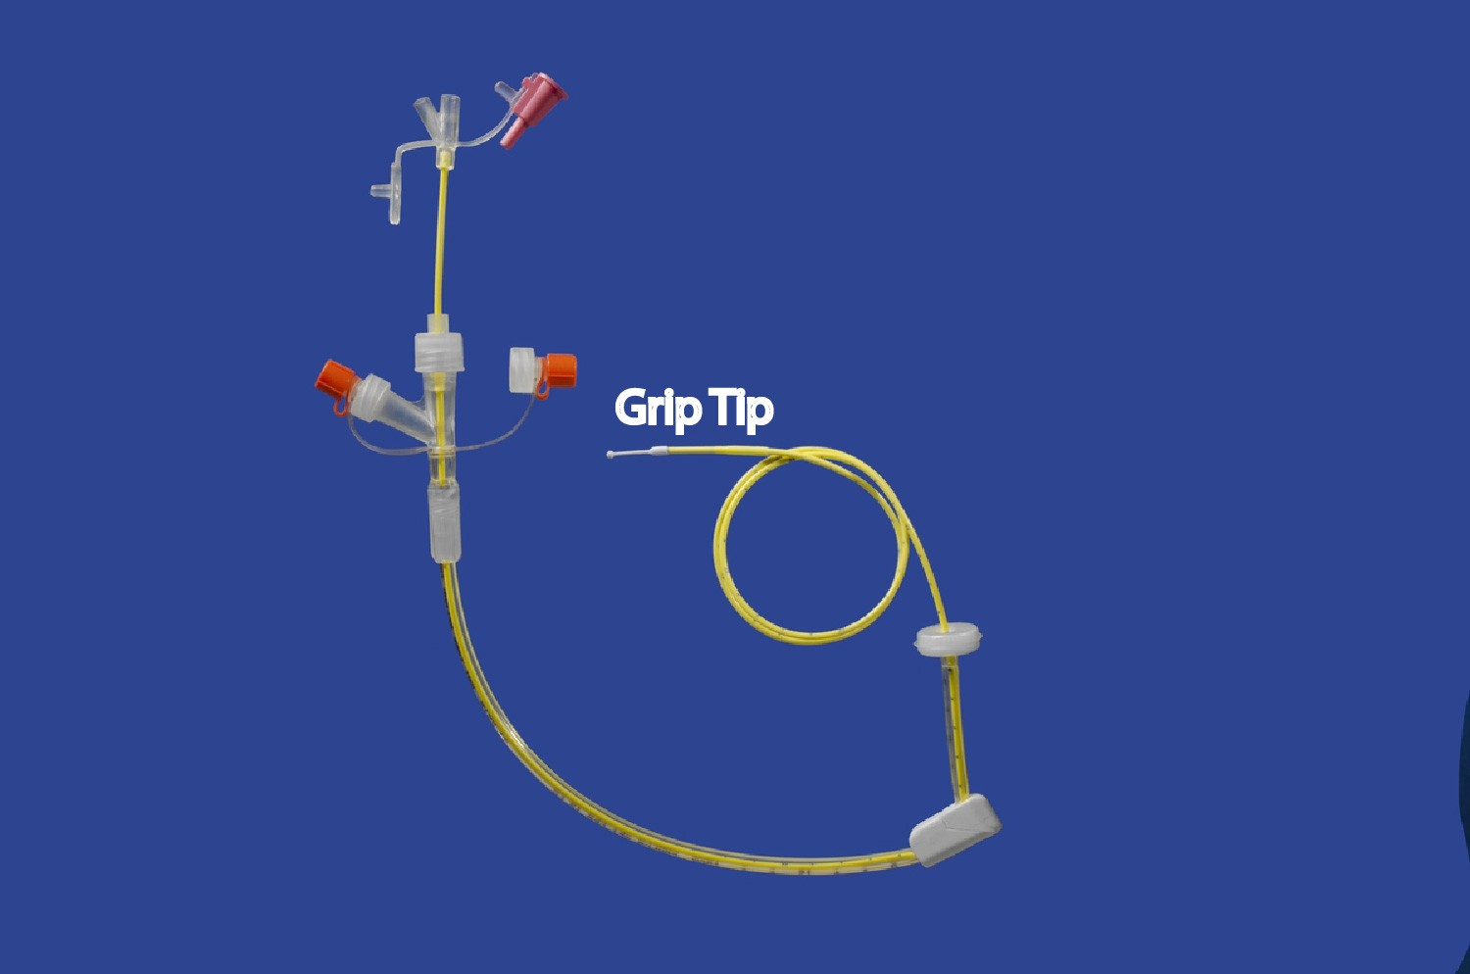
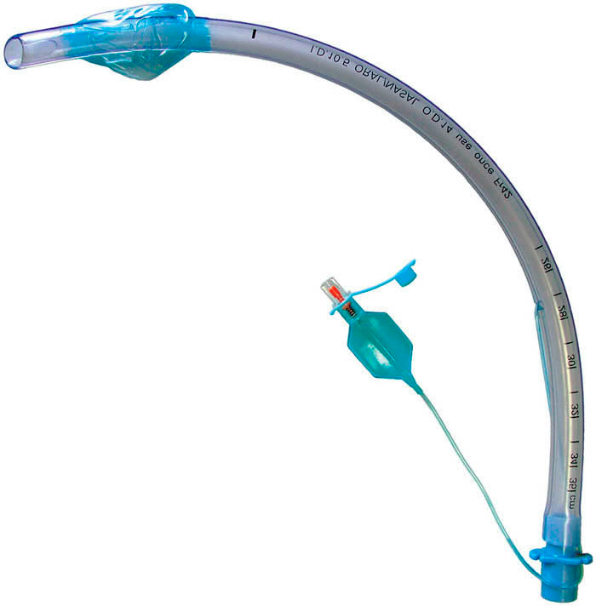
Gravity feeder / j tube

Slide 3
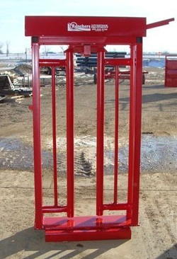
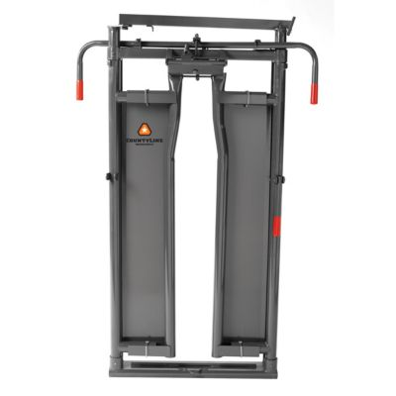
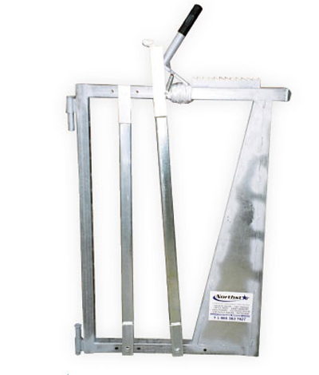
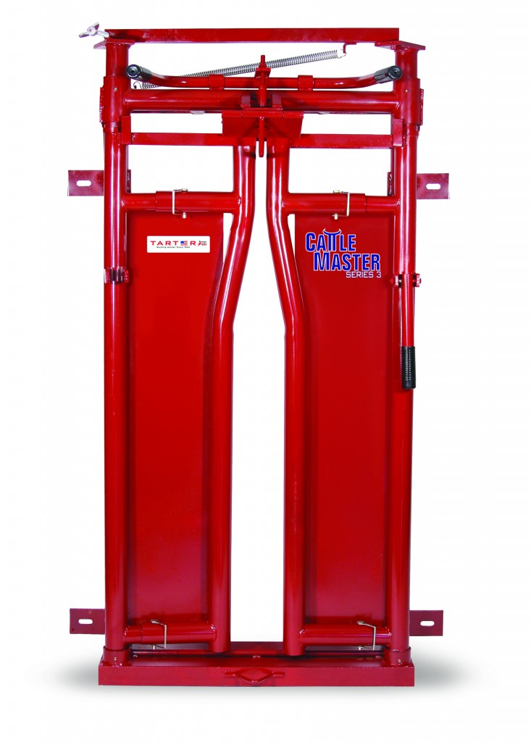
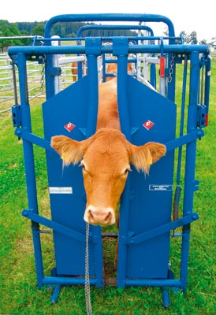
Head gate

Slide 4
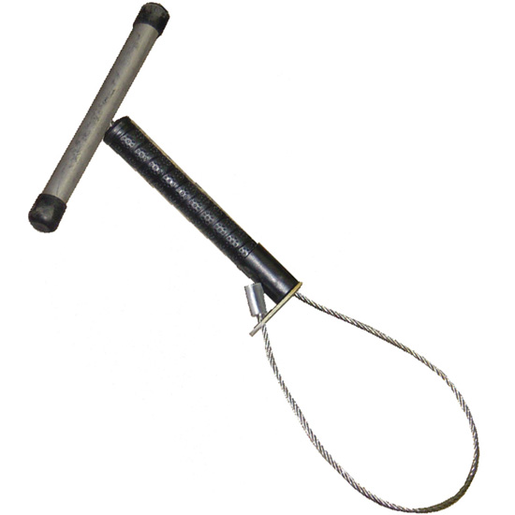
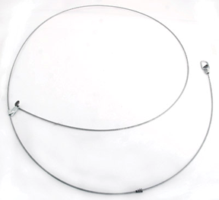
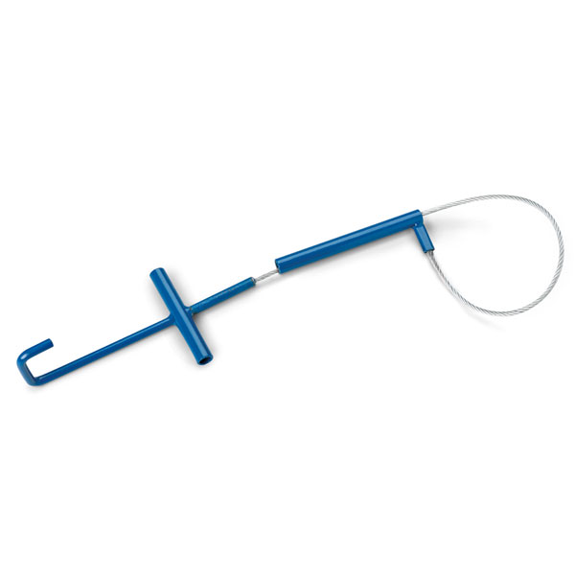
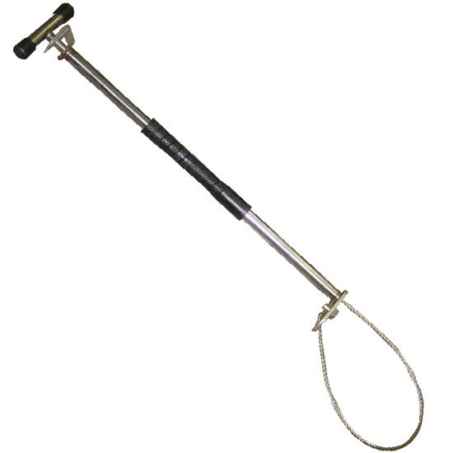
Hog snare

Slide 5
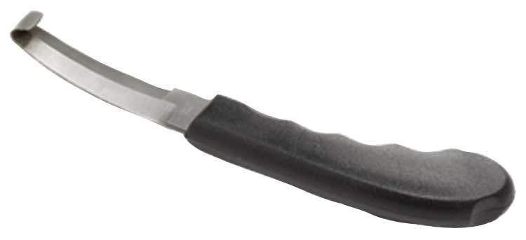
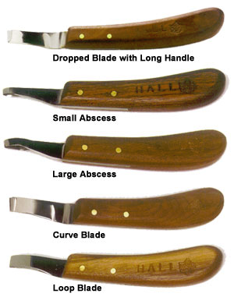
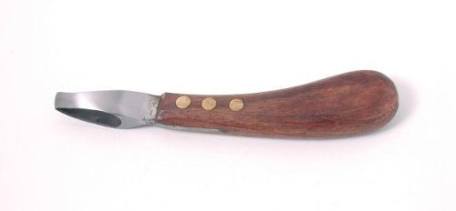
Hoof knife

Slide 6
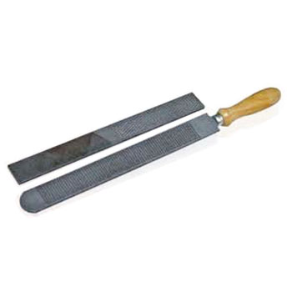
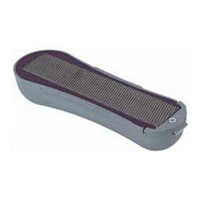
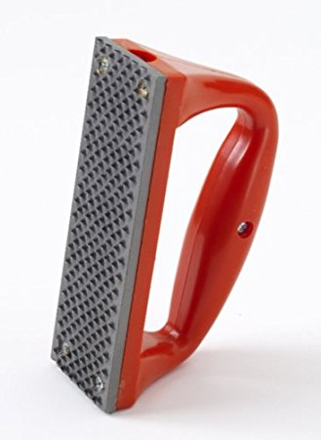
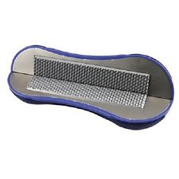
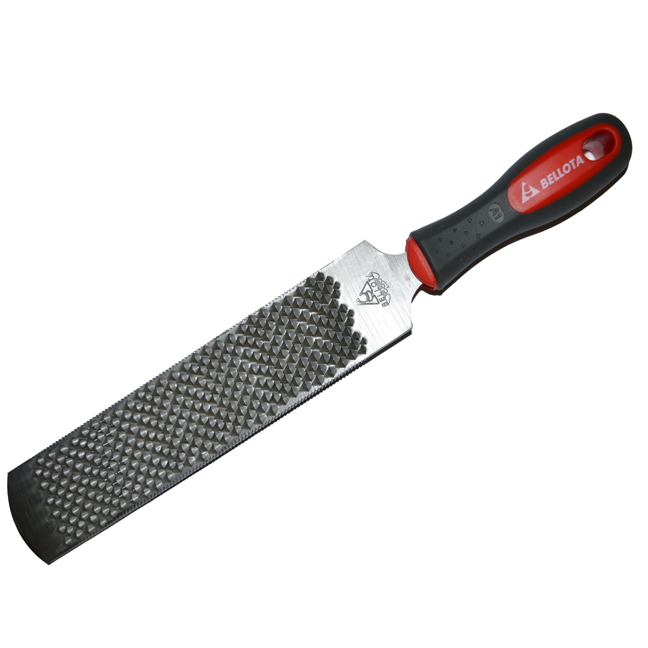
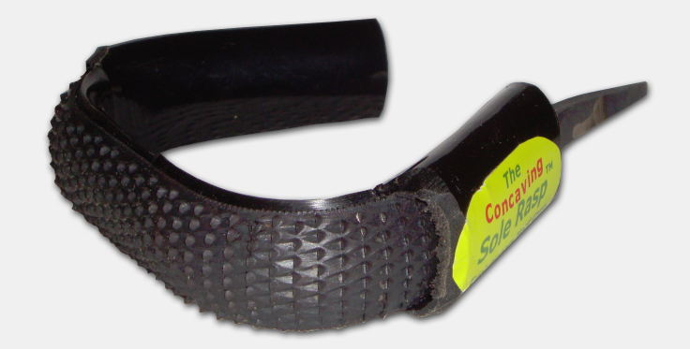
Hoof rasp

Slide 7
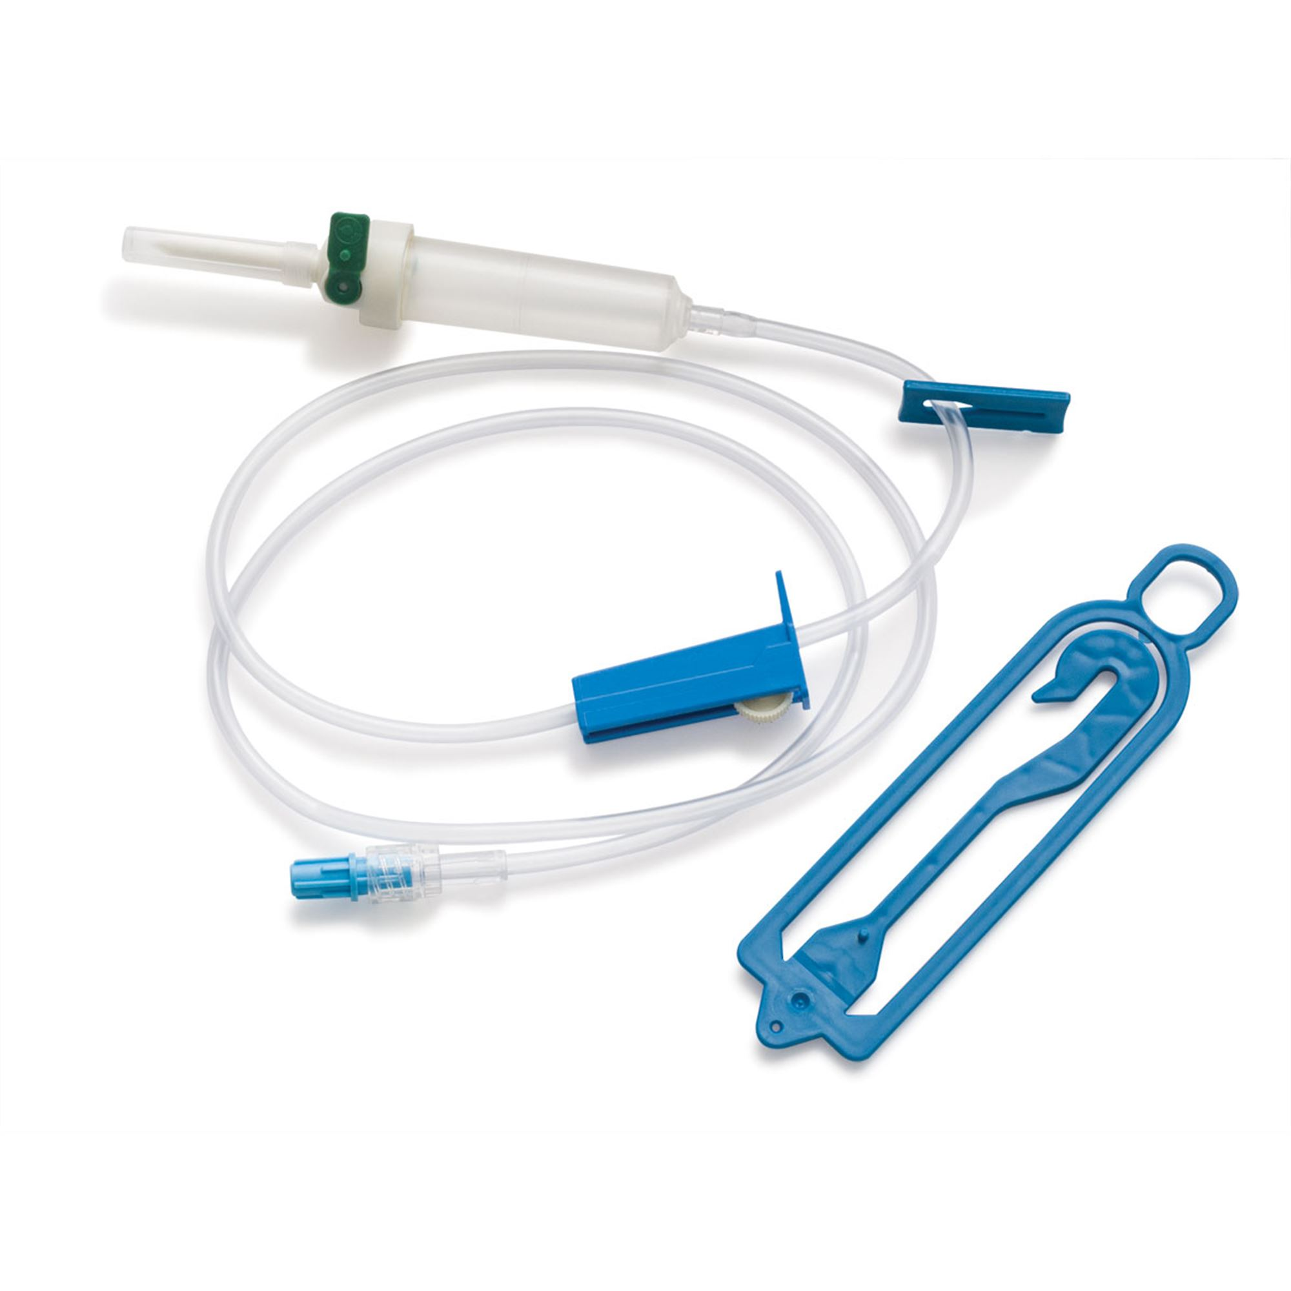
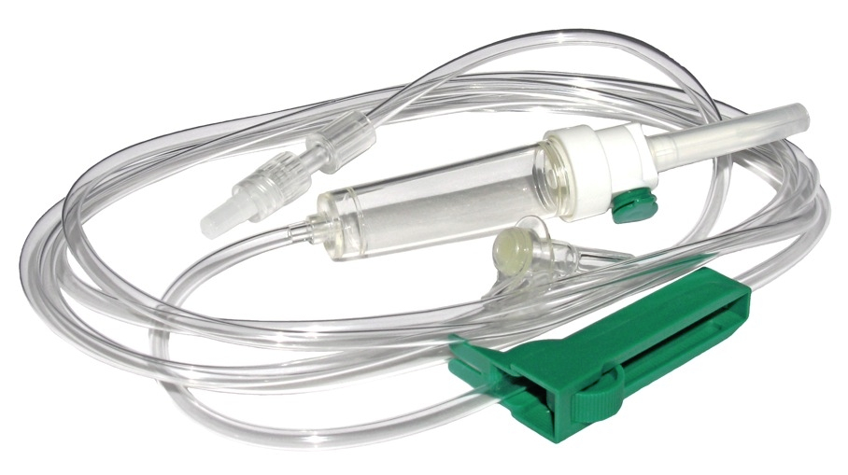
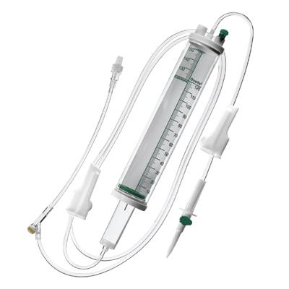
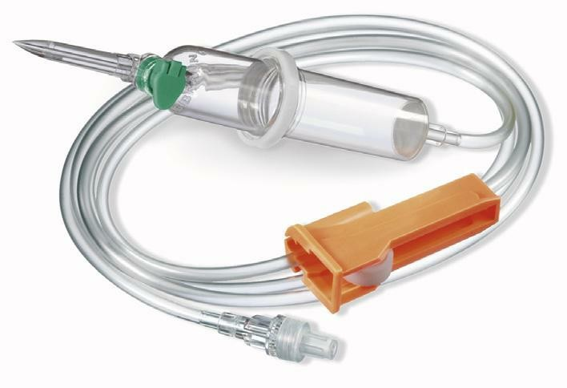
Iv administration set

Slide 8
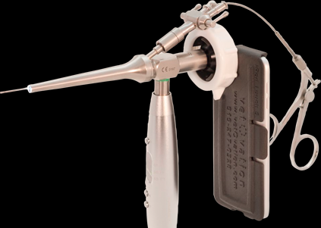
laparoscope

Slide 9
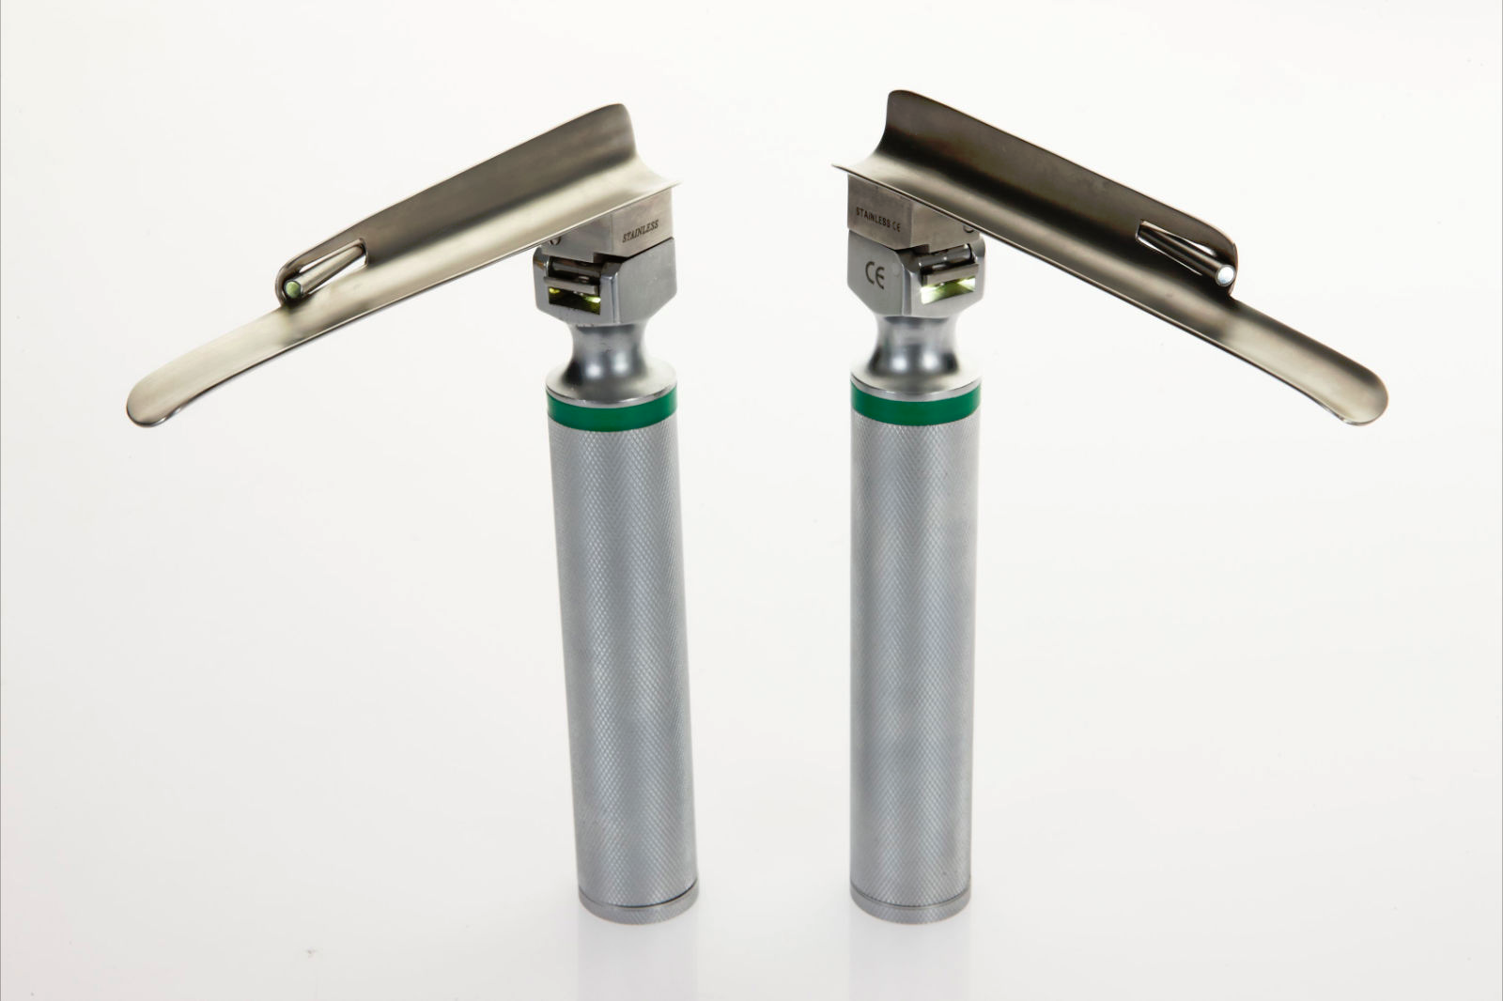
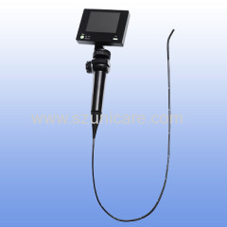
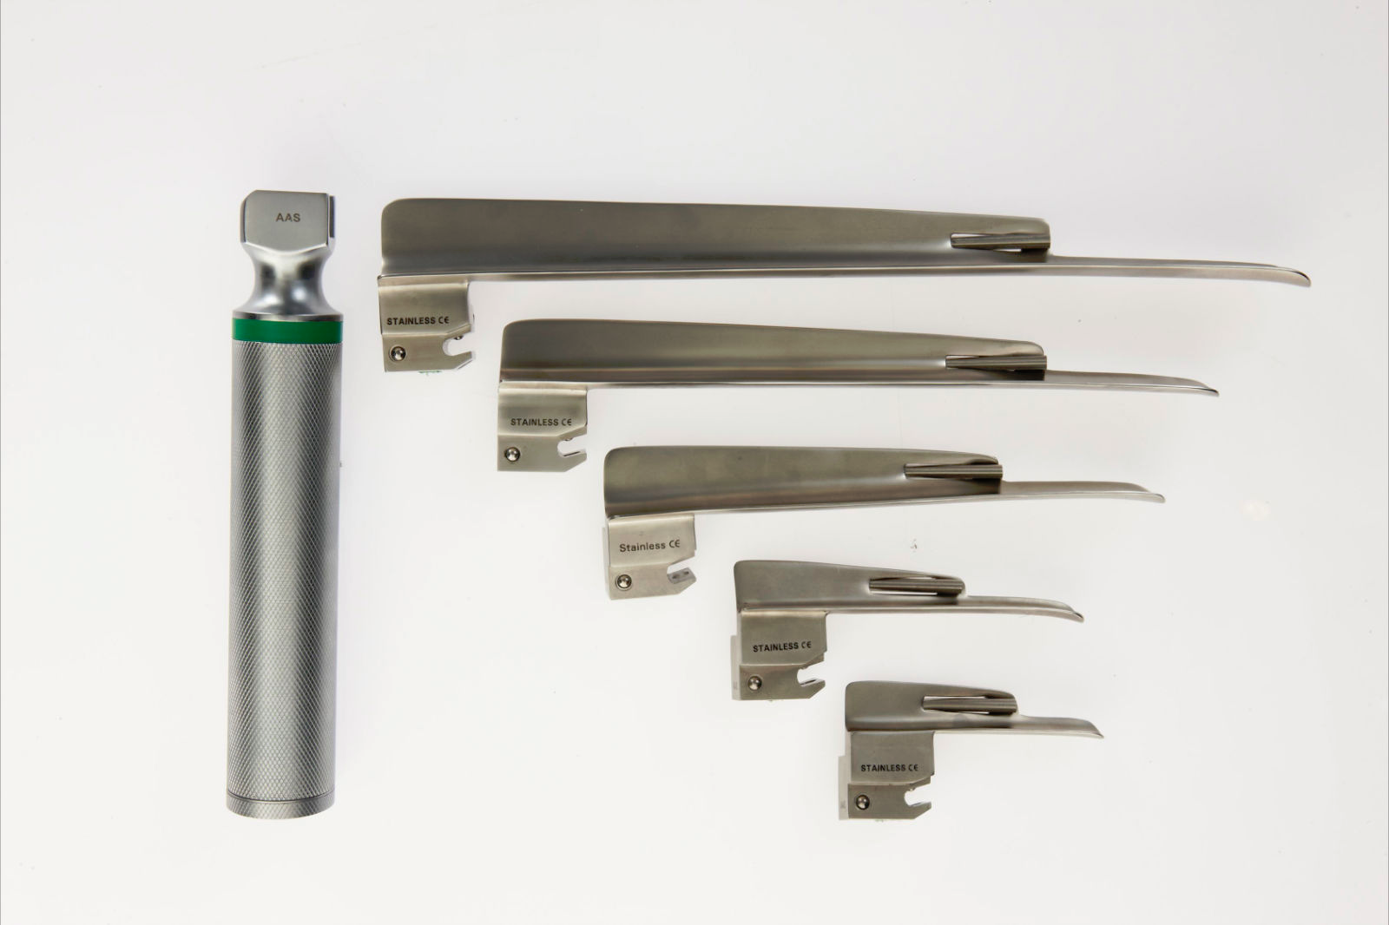
laryngoscope

Slide 10
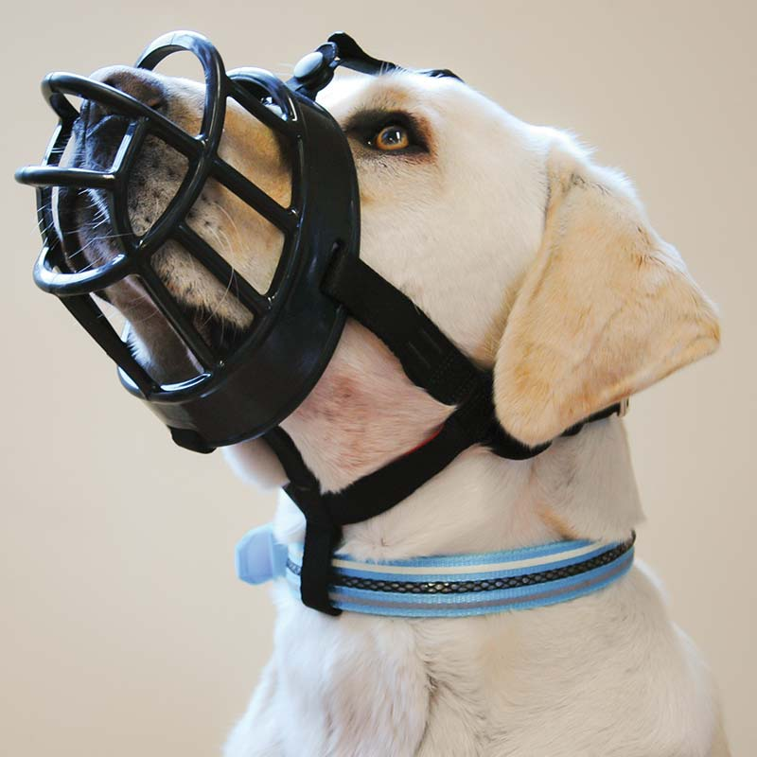
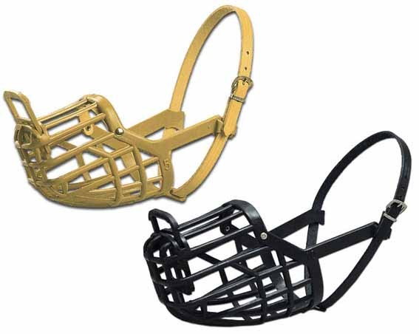
Muzzle - basket

Slide 11
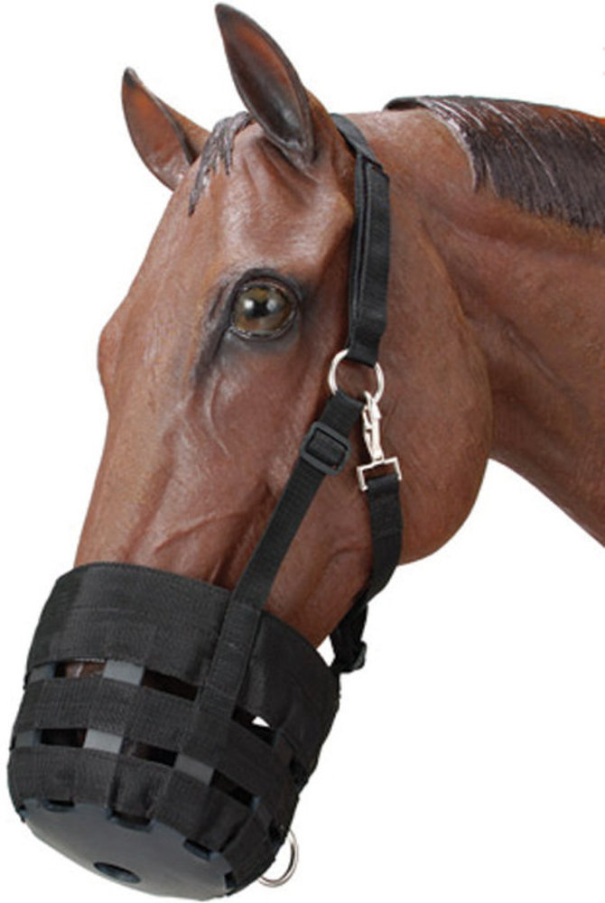
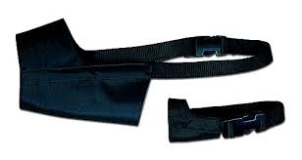
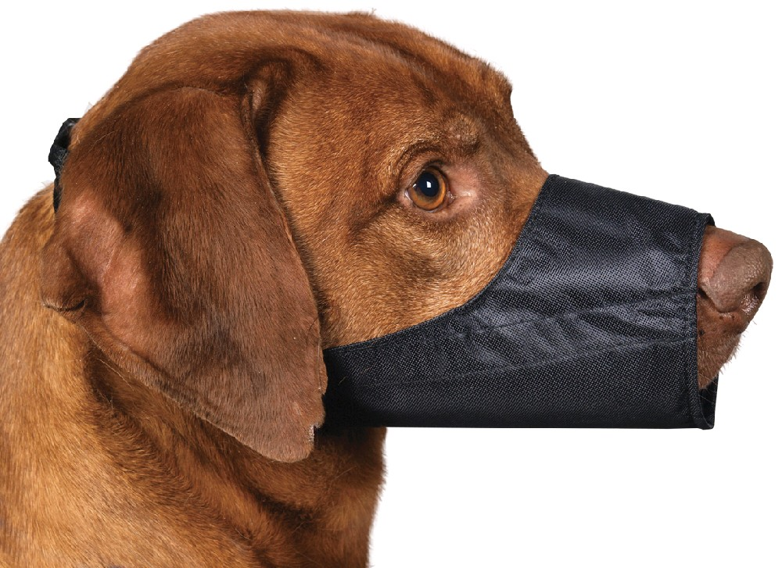
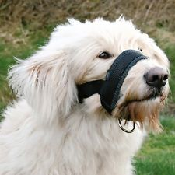
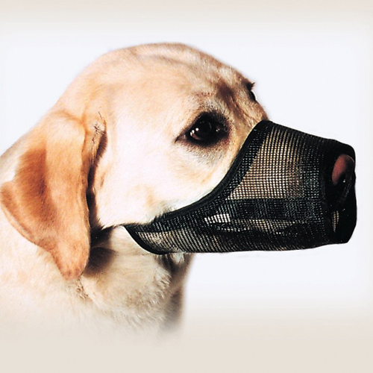
Muzzle - nylon

Slide 12
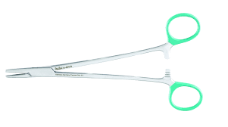
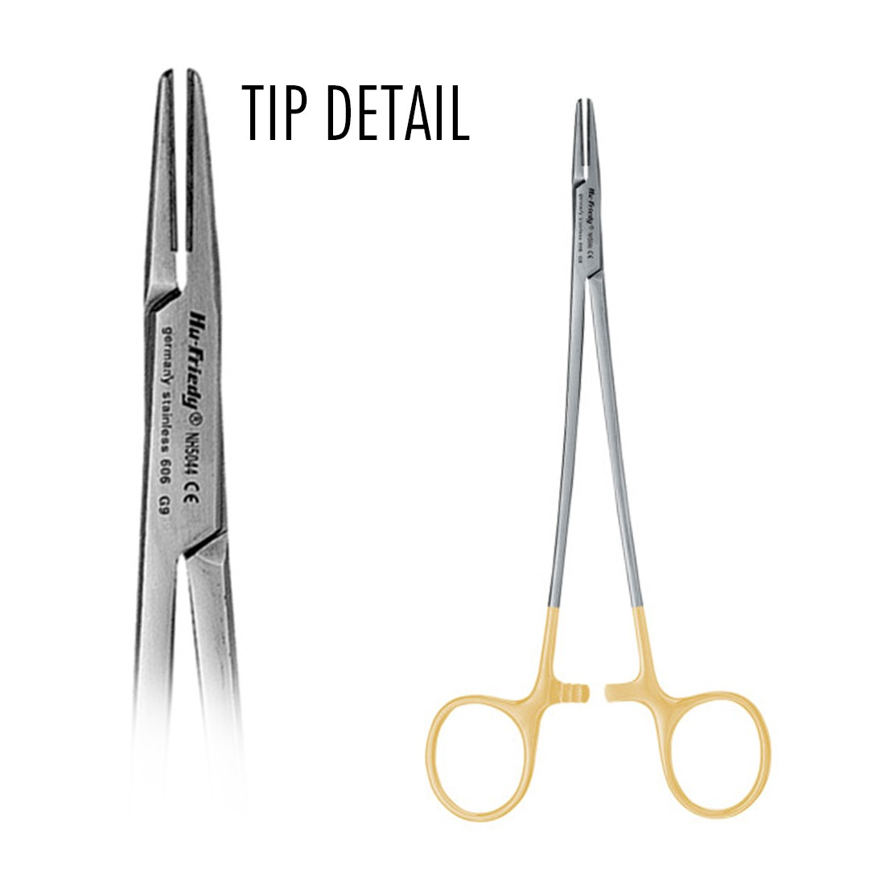
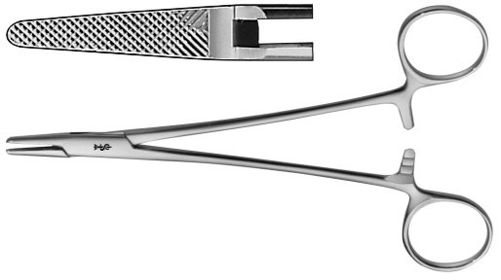
needle holder - Mayo-hegar

Slide 13
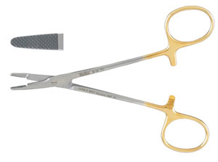
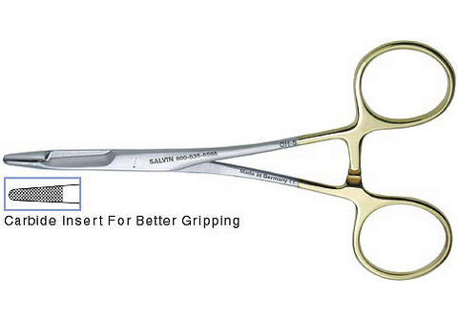
needle holder - Olsen-hegar

Slide 14
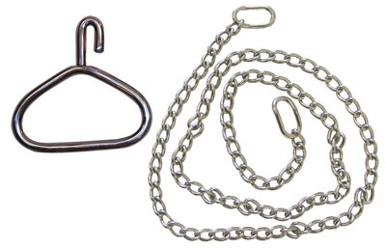
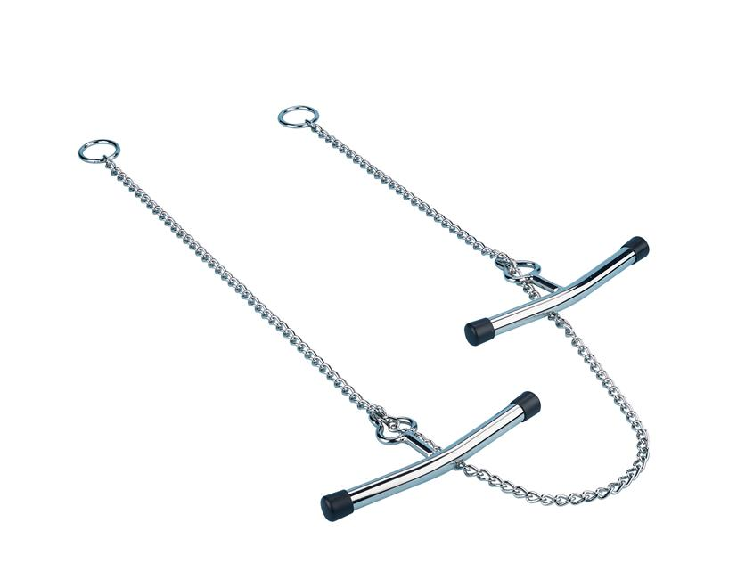
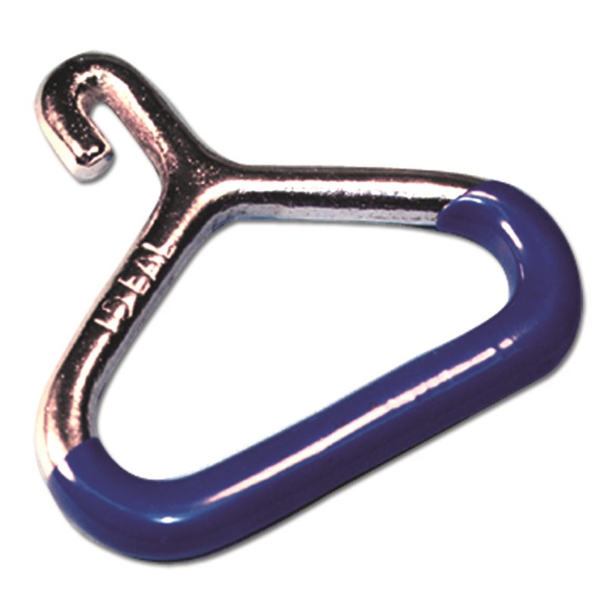
Obstetrical chain and handle

Slide 15
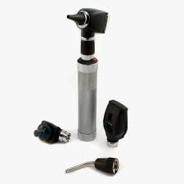
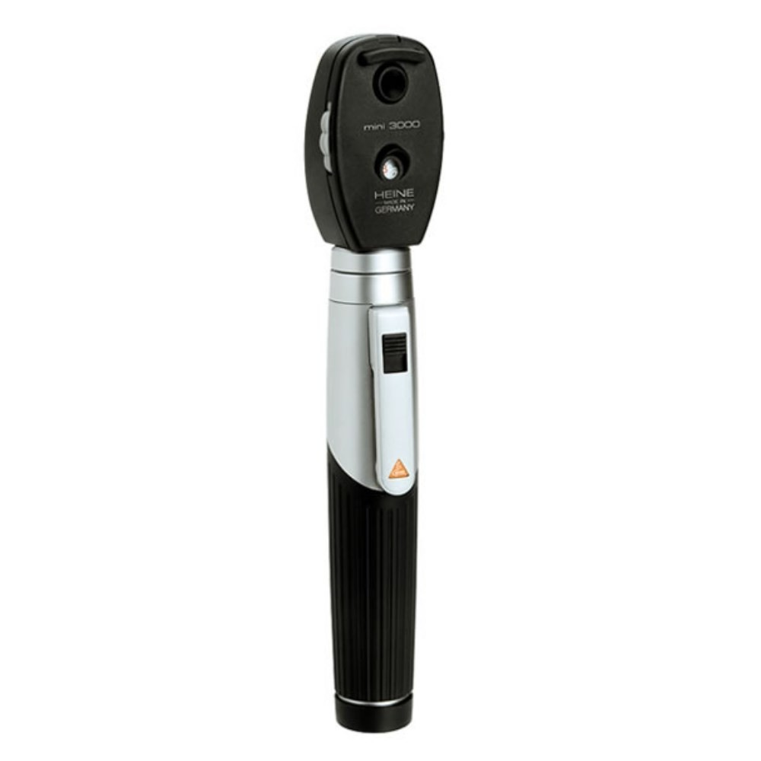
ophthalmoscope

Slide 16
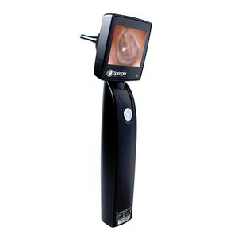
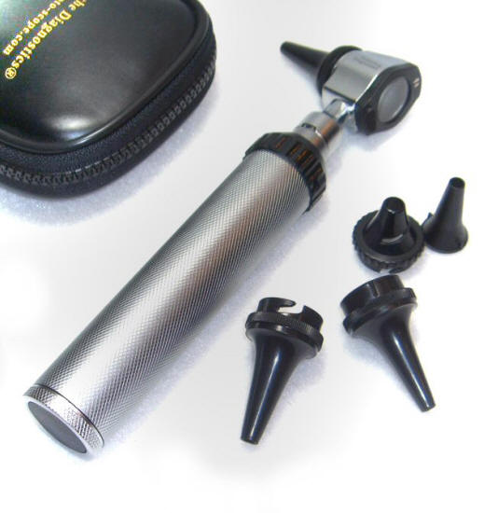
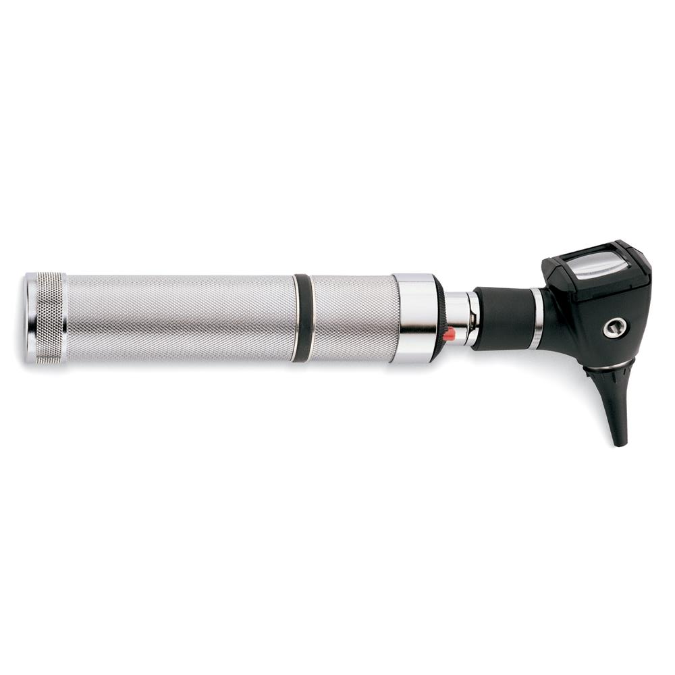
otoscope

Slide 17
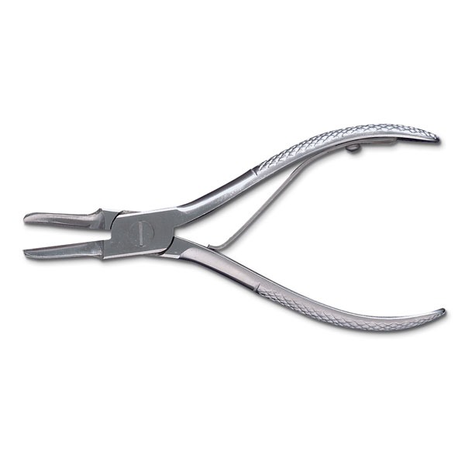
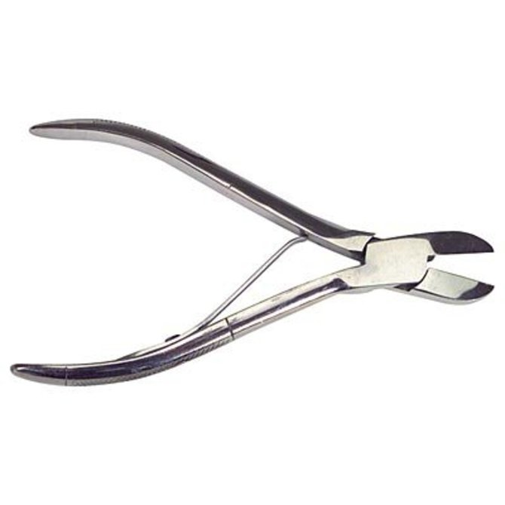
Pig tooth nipper

Slide 18
Radiology personal protective equipment

Slide 19
Rectal prolapse ring

Slide 20
Rumen magnet

Slide 21
Scalpel blade

Slide 22
Scalpel handle

Slide 23
Scissors – suture wire cutting
https://edpuzzle.com/assignments/589b88cdfb6a8a3e1335bd9b/watch
https://edpuzzle.com/assignments/589b88cdfb6a8a3e1335bd9b/watch

Slide 24
Scissors - Lister bandage

Slide 25
Scissors – littauer suture removal

Slide 26
Scissors – mayo dissecting

Slide 27
Scissors – metzenbaum dissecting

Slide 28
Silver nitrate stick

Slide 29
Small animal oxygen cage

Slide 30
Snook ovariohysterectomy hook

Slide 31
Speculum – large animal oral

Slide 32
Speculum – small animal oral

Slide 33
Speculum - vaginal

Slide 34
Squeeze chute

Slide 35
Staple remover

Slide 36
stethosope

Slide 37
Surgical drapes

Slide 38
Suture needle - cutting

Slide 39
Suture needle - taper

Slide 40
Syringe – automatic, mulitidose

Slide 41
Tattooing instrument – small and large

Slide 42
tonometer

Slide 43
tourniquet

Slide 44
Trocar and cannula

Slide 45
Twitch-chain

Slide 46
Twitch-humane

