Slide 1
Cat breeds

Slide 2
Abyssinian
Balanced medium sized animal of foreign type.
Beautiful ticked, resilient coats
Four common colors: Ruddy, Red, Blue and Cream

Slide 3
Domestic Shorthair
Wide range of coloring
Not purebred cats, but are of mixed ancestry

Slide 4
Burmese
Medium sized cat with a rounded head, expressive eyes and a sweet disposition
Many colors are recognized, but the 4 main ones are sable, champagne, blue and platinum

Slide 5
Maine Coon
Head is slightly longer than it is wide, ears are wide at the base, moderately pointed and well tufted inside
Wide range of colors and patterns
Tail is as long as torso

Slide 6
Manx
Stocky, solid cat with a dense double coat, a compact body, very short back, hind legs that are visibly longer than front legs, big bones, wide chest and greater depth of flank
All colors and patterns exist in both coat lengths

Slide 7
Persian
Available in a veritable rainbow of colors and patterns
Most popular and perhaps the most recognized breed of cats

Slide 8
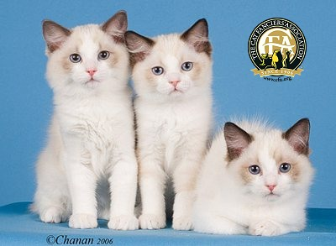
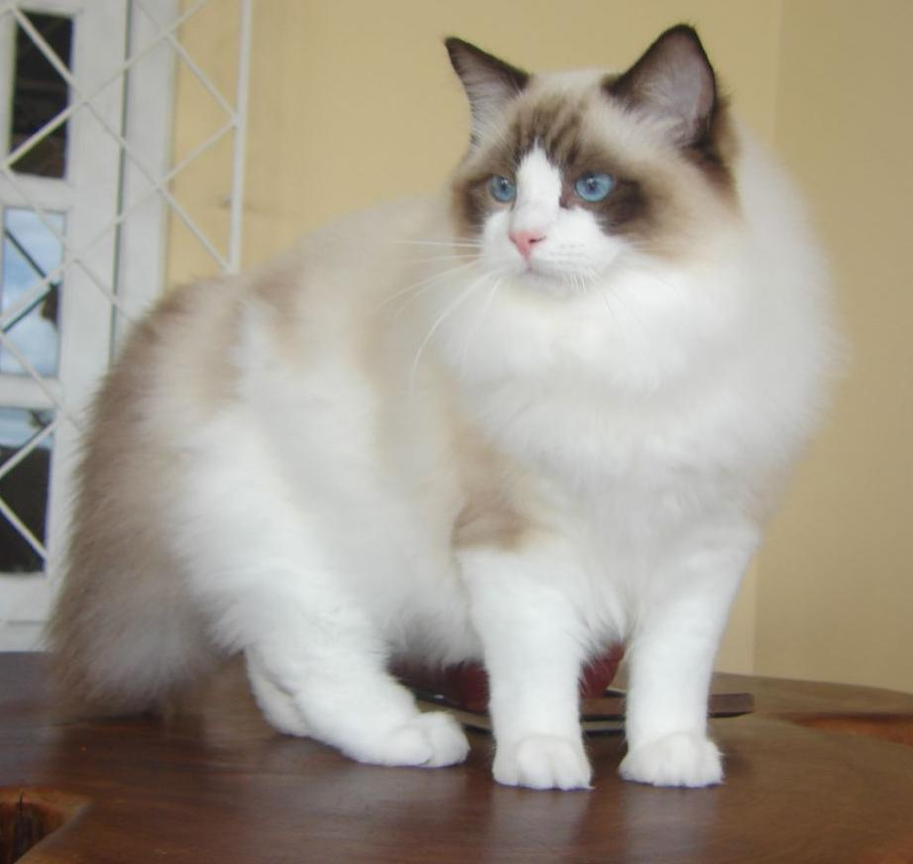
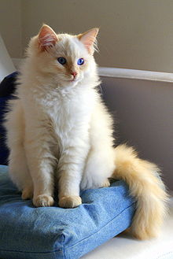
Ragdoll

Slide 9
Russian Blue
Noted for its short, plush, silvery blue coat, brilliant green eyes and semi-foreign body type with long legs and body
Solid silvery blue coats

Slide 10
Siamese
One of the oldest recognized and established breeds of cats
Distinguished by its brilliant blue eyes and its colored points which provide contrast to its light colored body.

Slide 11
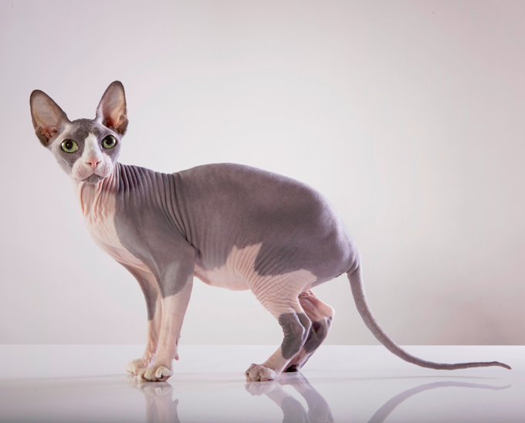
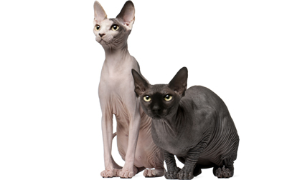
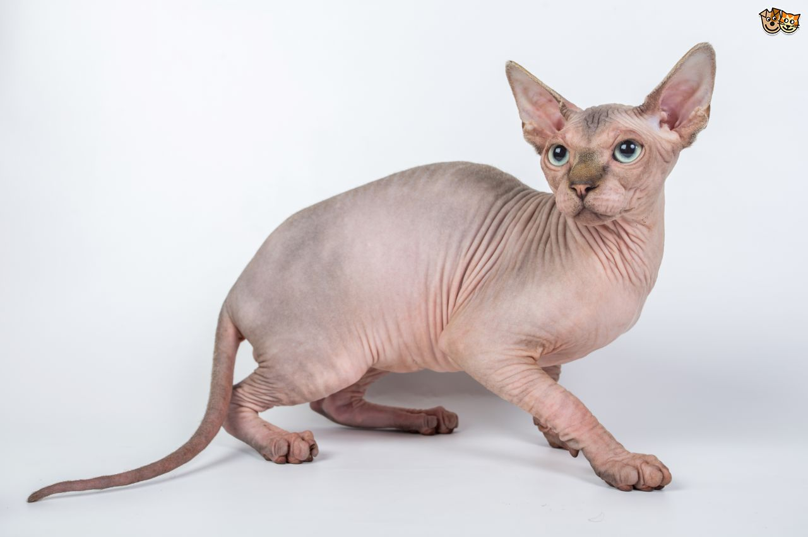
Sphynx

