Slide 1
Plant ID

Slide 2
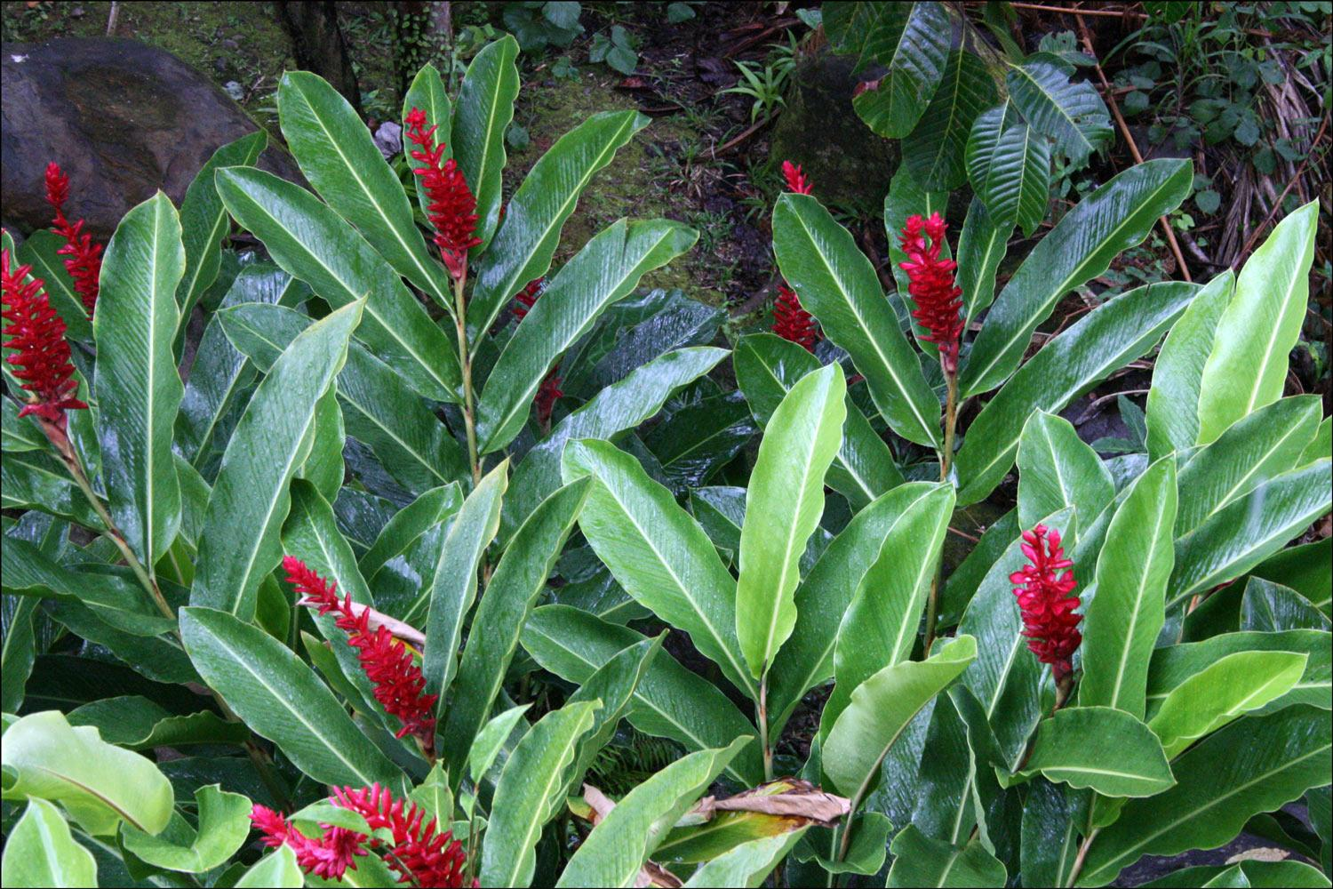
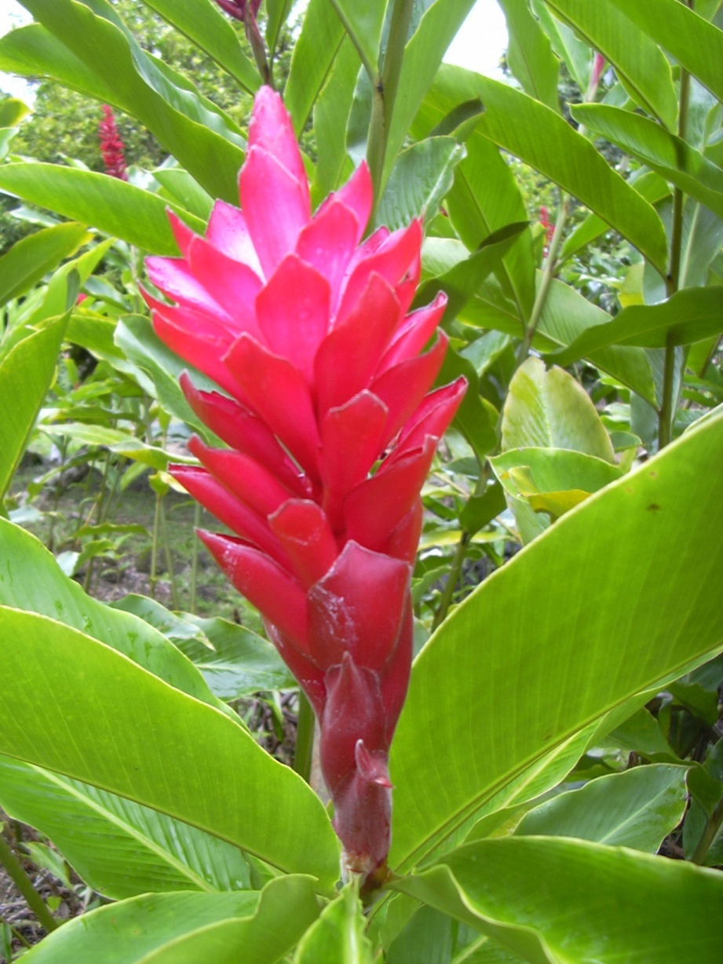
Alpinia purpurata – Red Ginger

Slide 3
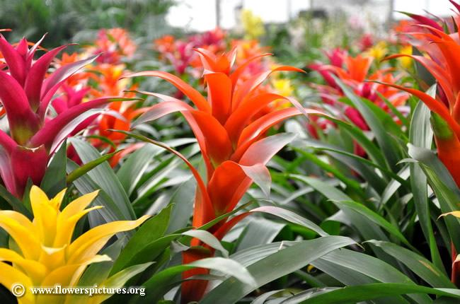
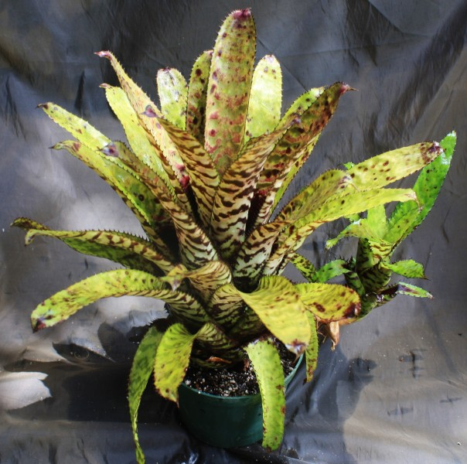
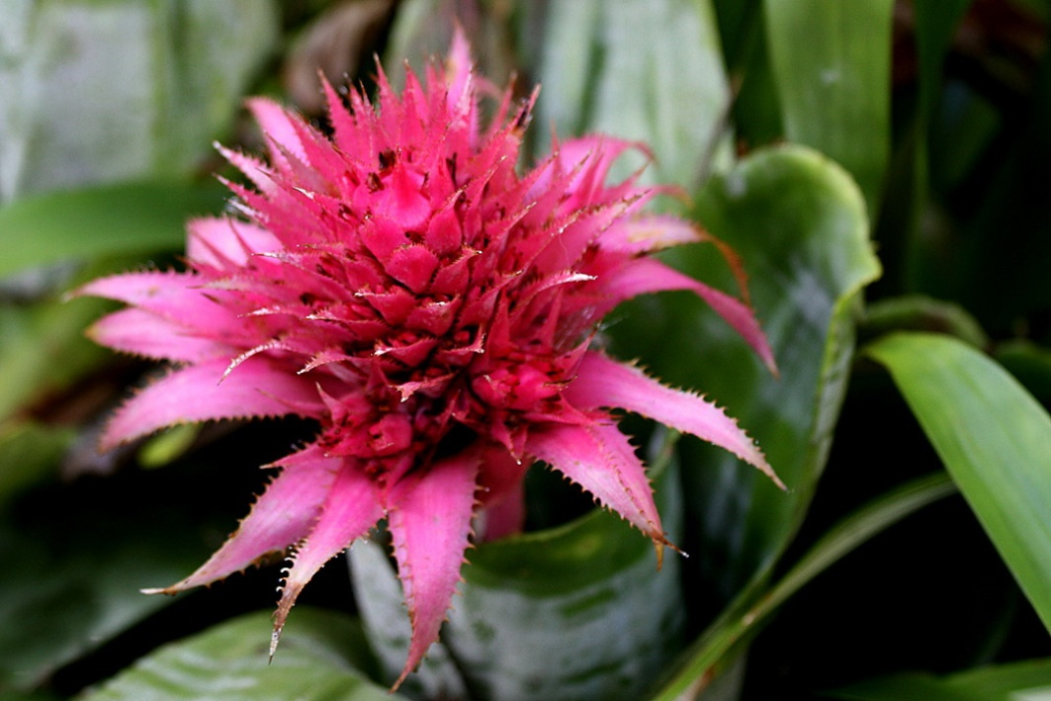
Aechmea cv. – Bromeliad

Slide 4
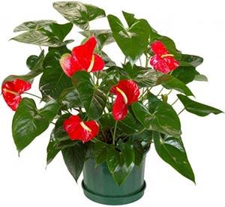
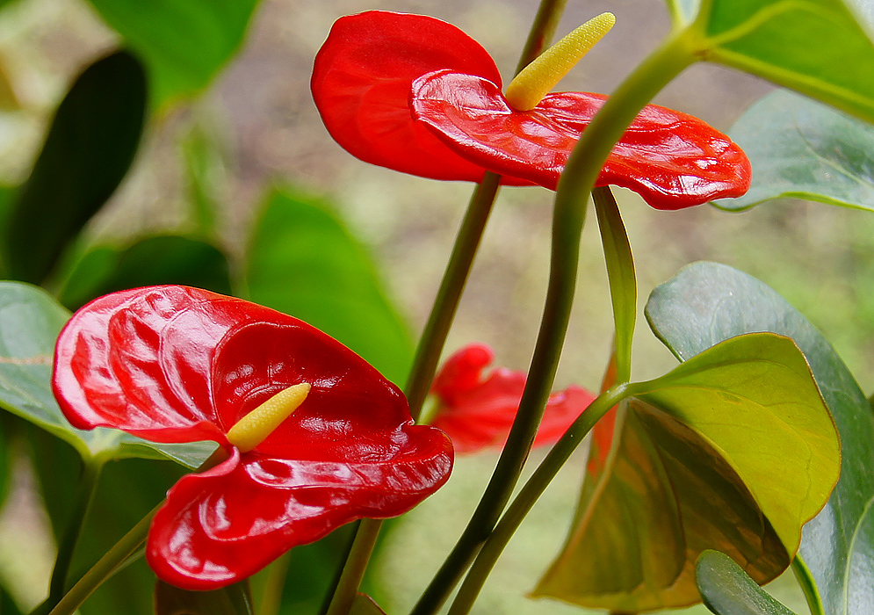
Anthurium andraenum -Anthurium

Slide 5
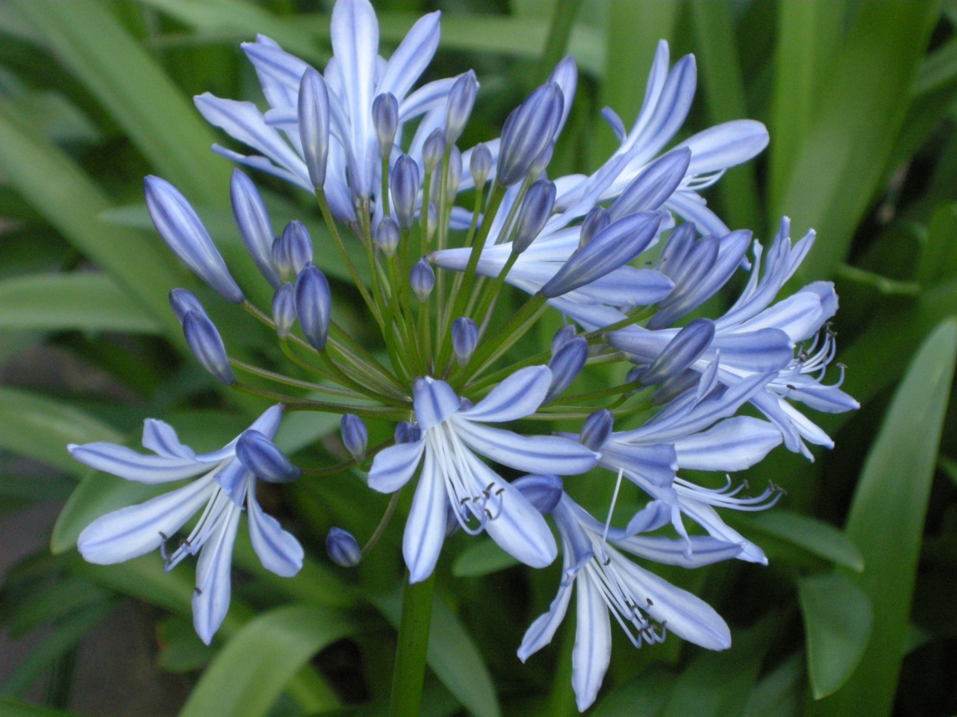
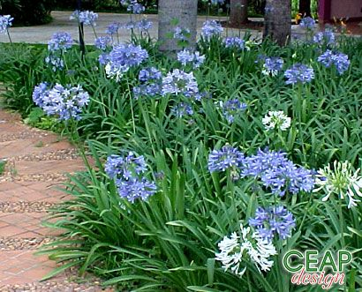
Agapahthus africanus – African Lily

Slide 6
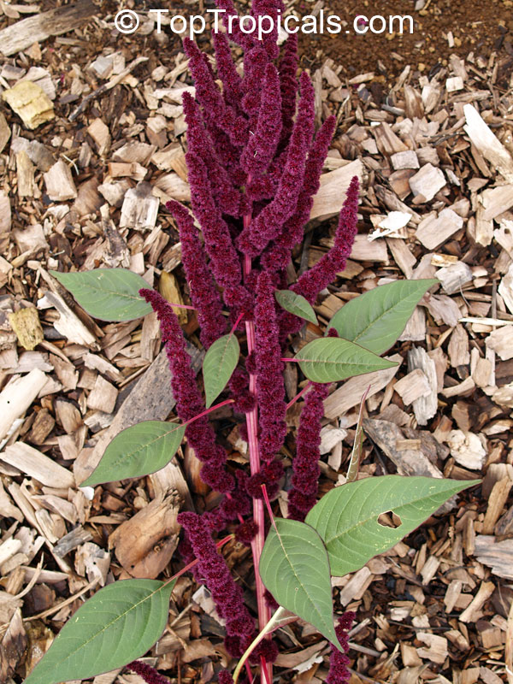
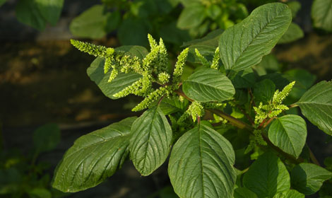
Amaranthus sp. – Amaranthus, amaranthus cv.

Slide 7
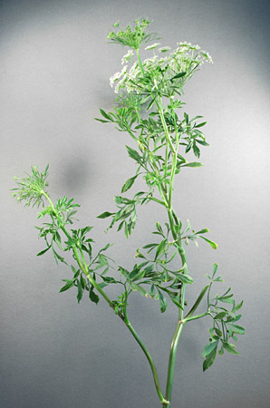
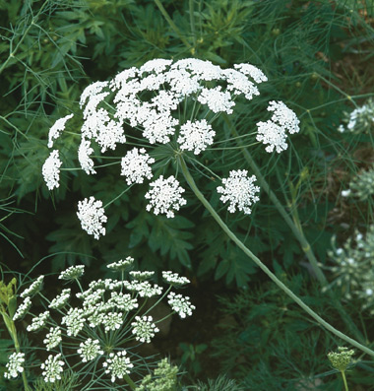
Ammi majus – Queen’s Anne’s Lace, Laceflower

Slide 8
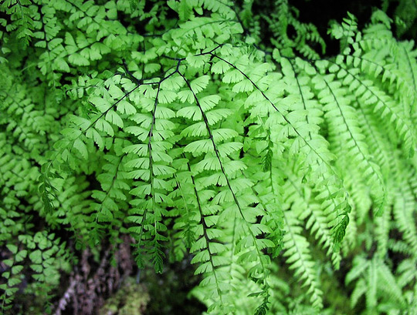
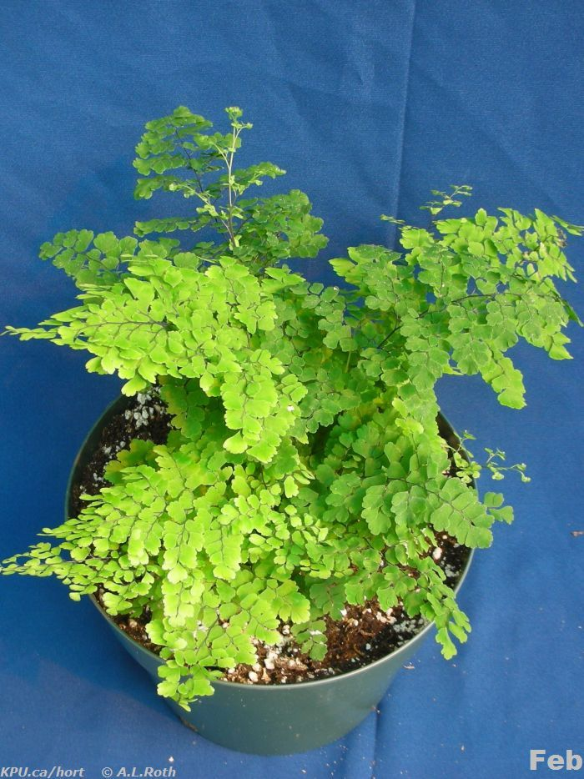
Adiantum spp. – Maidenhair Fern

Slide 9
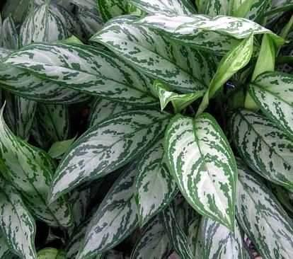
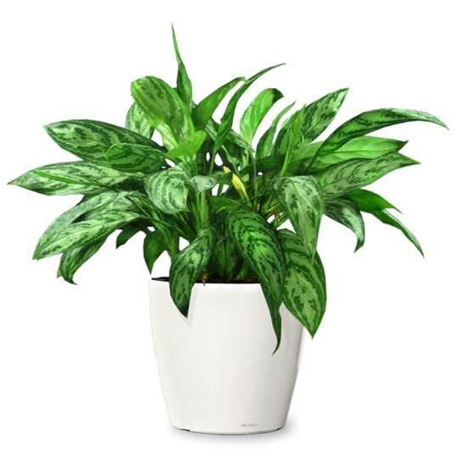
Aglaonema commutatum cv. – Aglaonema, Chinese Evergreen

Slide 10
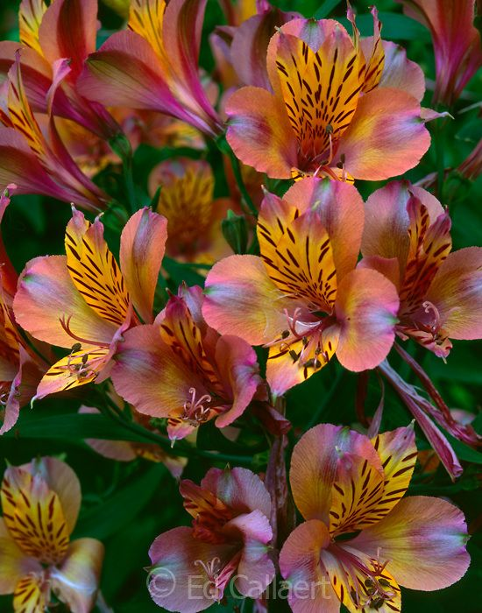
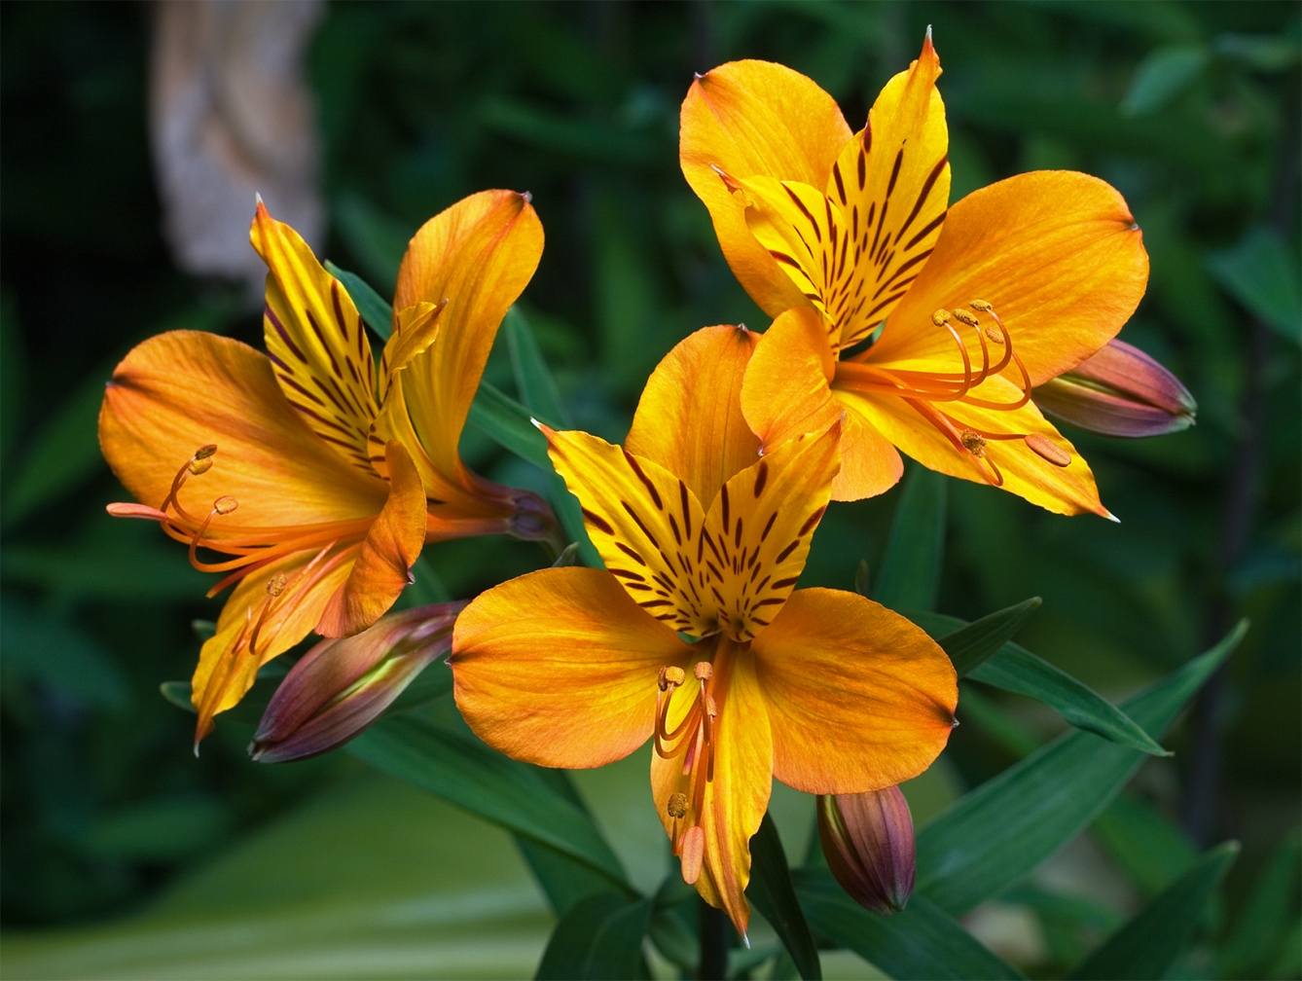
Alstroemeria aurantiaca – Alstroemeria, Peruvian Lily

Slide 11
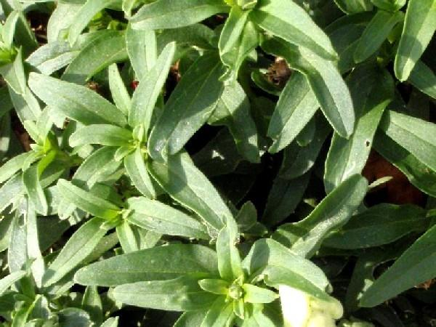
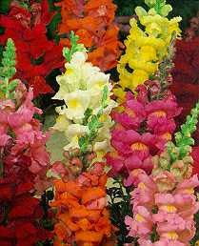
Antirrhinum majus cv. – Snapdragon

Slide 12
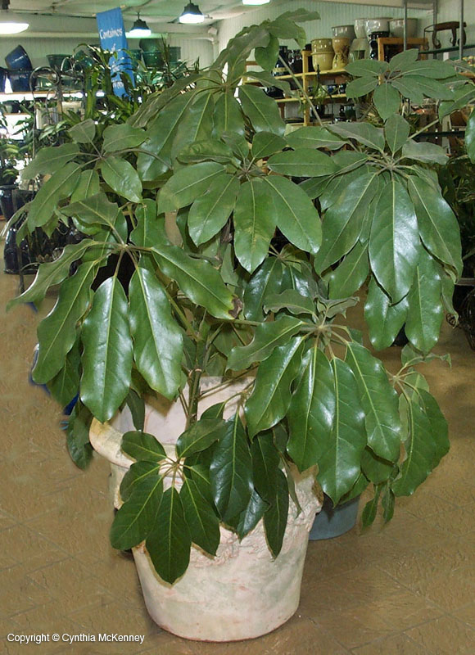
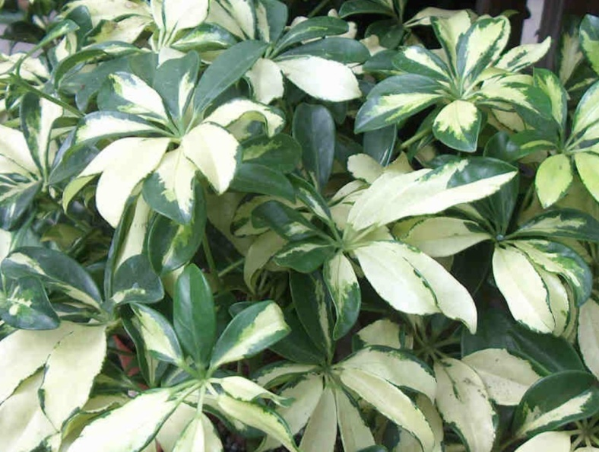
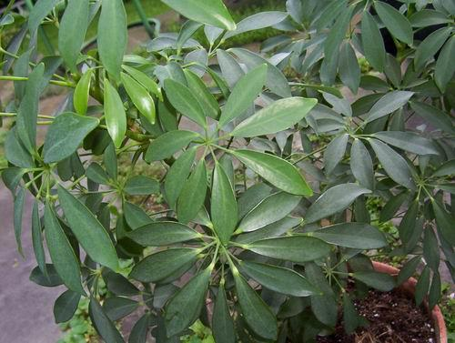
Brassaia actinophylla – Schefflera, Octopus Tree

Slide 13
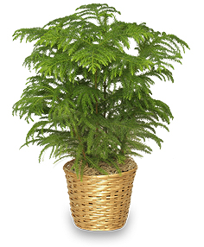
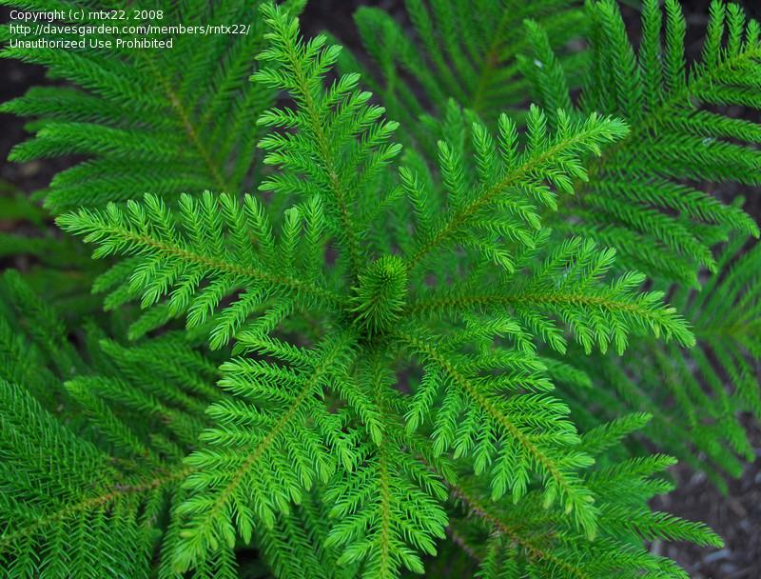
Araucaria heterophylla – Norfolk Island Pine

Slide 14
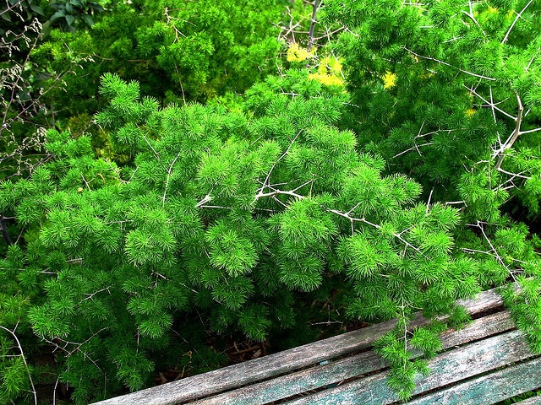
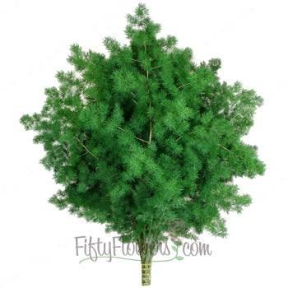
Asparagus densiflorus ‘Myriocladus’ – Ming Fern

Slide 15
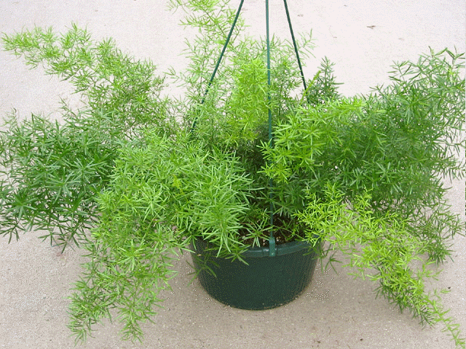
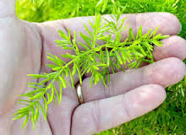
Asparagus densiflorus ‘Sprengeri’ – Sprengeri Fern

Slide 16
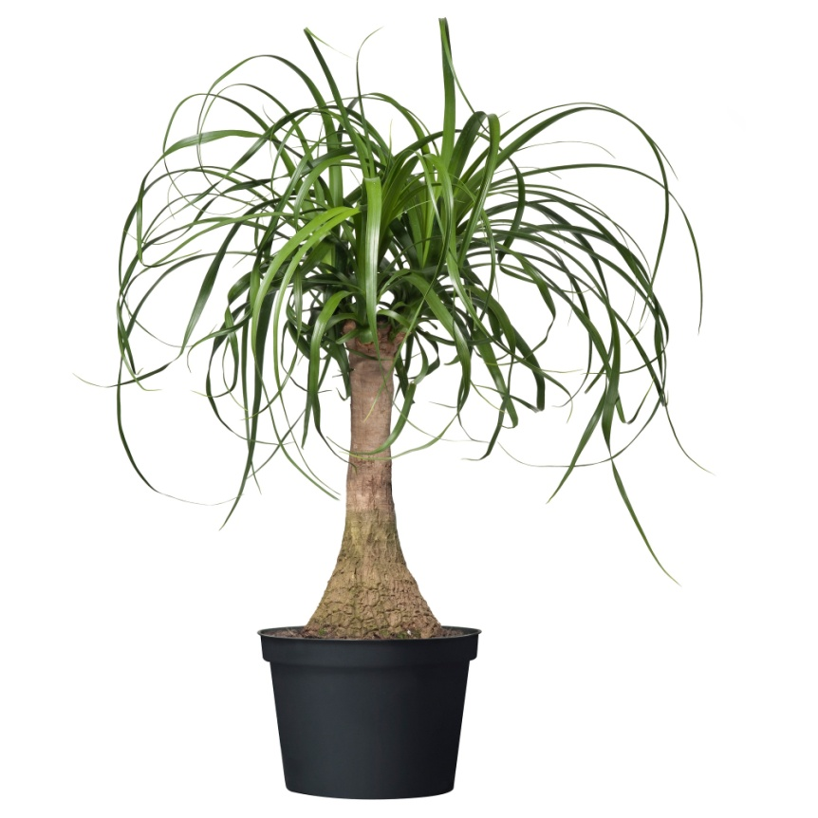
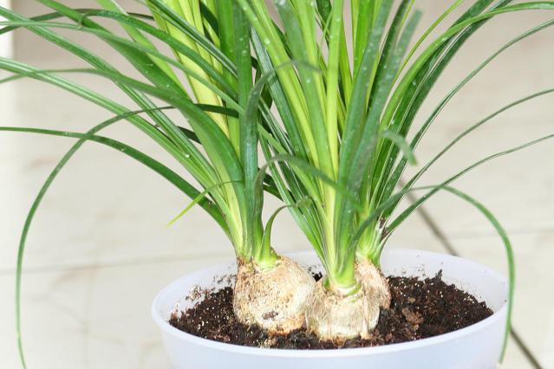
Beaucarnea recurvata – Ponytail Palm

Slide 17
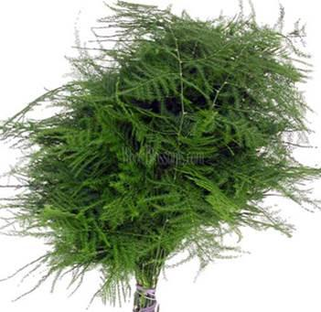
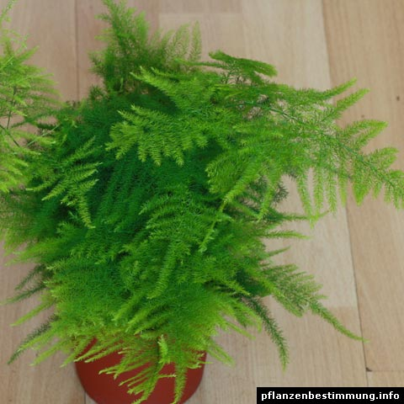
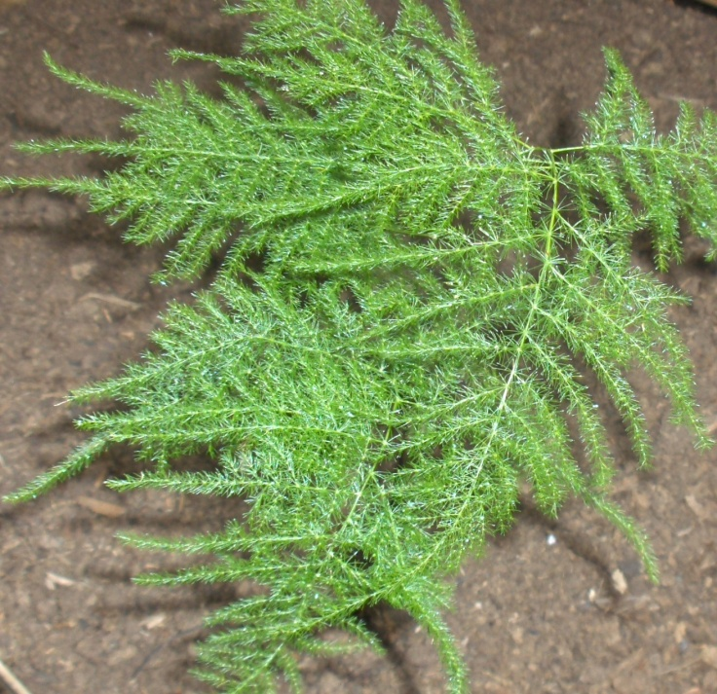
Asparagus setaceus – Plumosa Fern

Slide 18
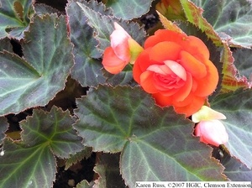
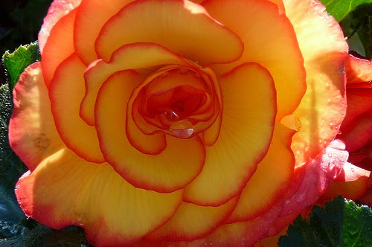
Begonia x tuberhybrida cv. – Tuberous Begonia

Slide 19
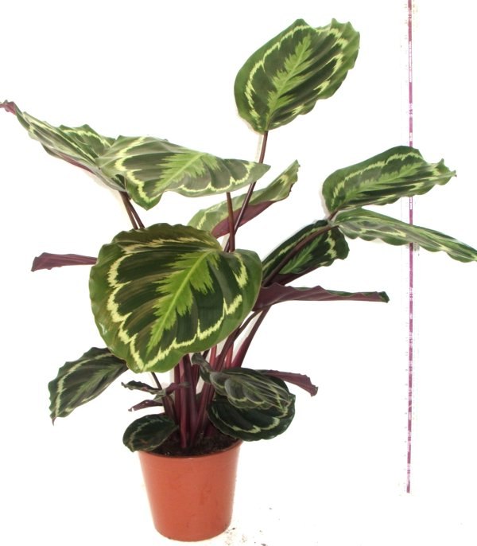
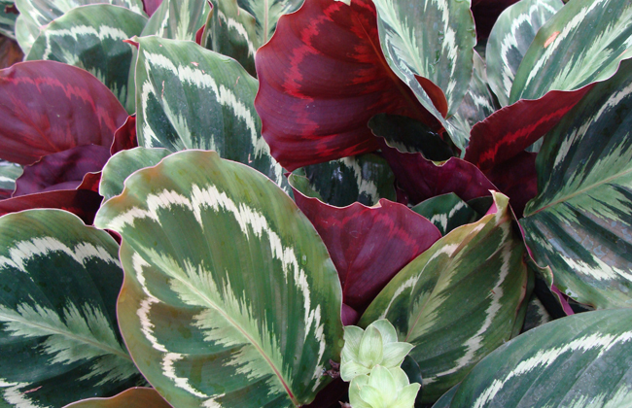
Calathea roseopicta - Calathea

Slide 20
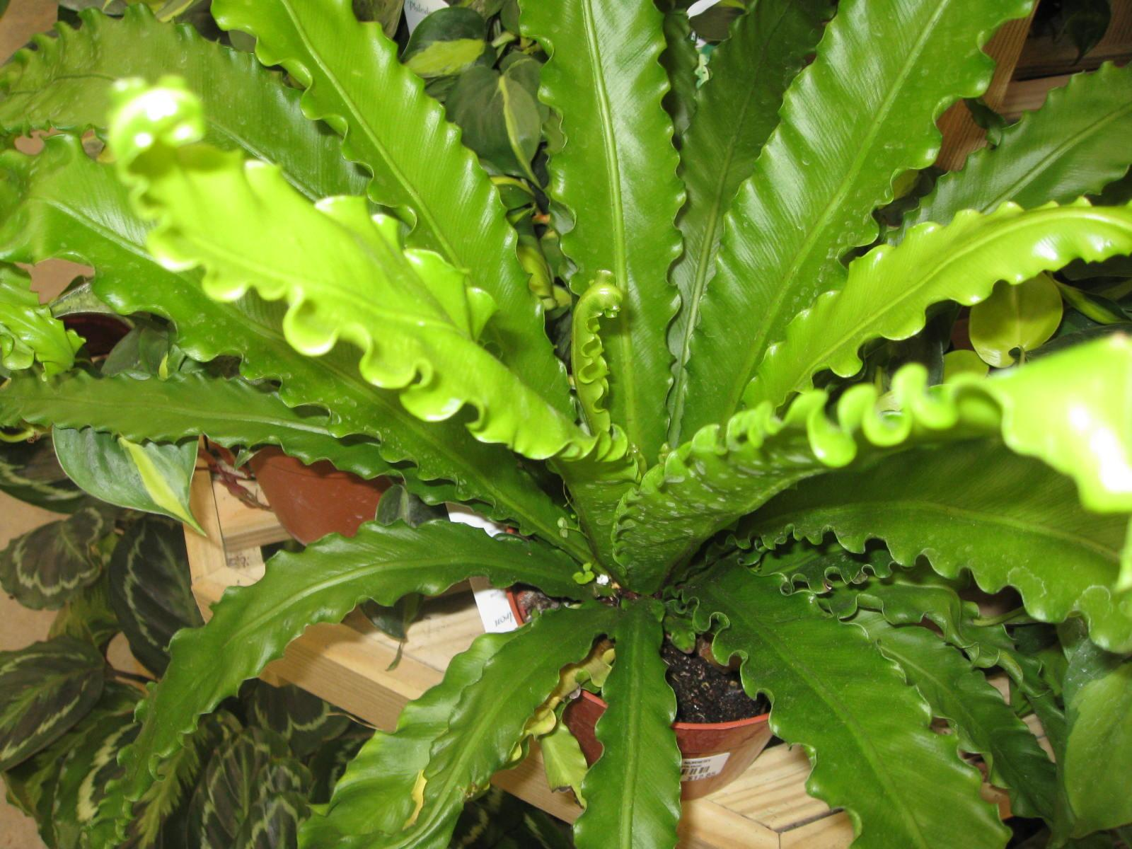
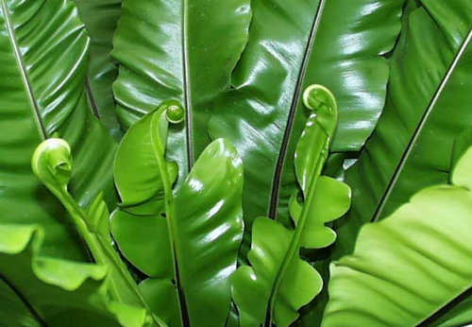
Asplenium nidus – Bird’s Nest Fern

Slide 21
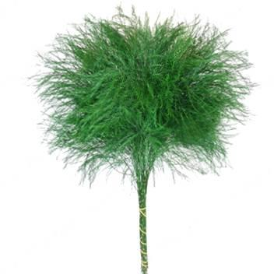
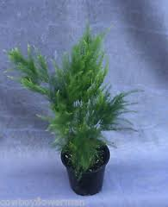
Asparagus setaceus ‘Pyramidalis’ – Tree Fern

Slide 22
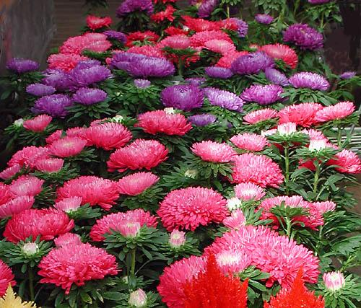
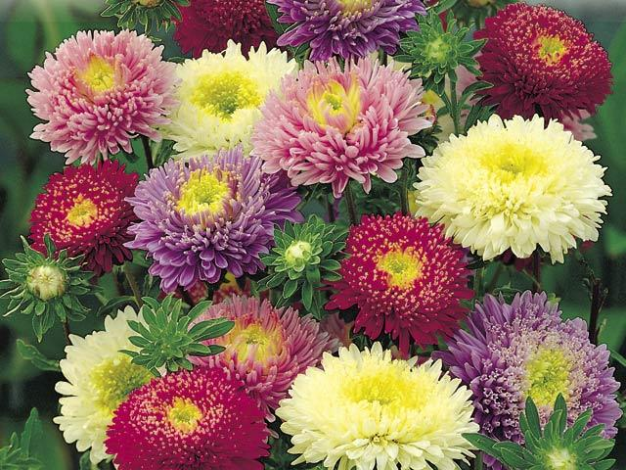
Callistephus chinensis hybrids – Chinese Aster

Slide 23
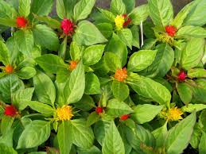
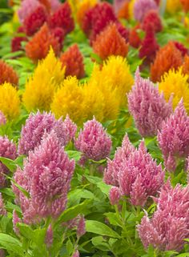
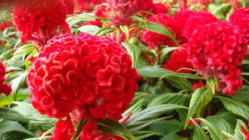
Celosia argentea cv. – Celosia, Cockscomb

Slide 24
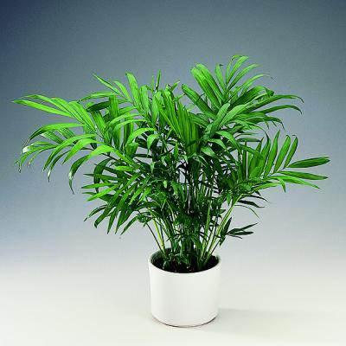
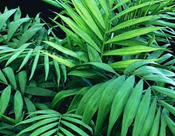
Chamaedorea elegans – Parlor Palm, Commodore Palm

Slide 25
Chamelaucium uncinatum – Waxflower

Slide 26
Consolida ambigua cv. – Larkspur

Slide 27
Chlorophytum comosum var. – Spider Plant

Slide 28
Cordyline terminalis – Ti Plant

Slide 29
Chrysanthemum x monifolium cv. – Florist’s Chrysanthemum

Slide 30
Chrysanthemum x monifolium cv. – Spider Chrysanthemum

Slide 31
Codiaeum variegatum cv. – Croton

Slide 32
Cyclamen persicum cv. – Florist’s Cyclamen

Slide 33
Crassula argentea – Jade Plant

Slide 34
Dendrobium spp. – Dendrobium Orchid

Slide 35
Dieffenbachia spp. – Dumbcane

Slide 36
Delphinium elatum – Delphinium

Slide 37
Dizygotheca elegantissima – False Aralia

Slide 38
Dahlia cv. - Dahlia

Slide 39
Dracaena cv.

Slide 40
Dianthus caryophyllus cv. – Florist Carnation

Slide 41
Dianthus caryophyllus cv. – Florists Carnation
Cymbidium cv. – Cymbidium Orchid

Slide 42
Dracaena marginata var. – Red-margined Dracaena

Slide 43
Epipremnum aureum cv. – Golden pothos, Devil’s Ivy

Slide 44
Erica carnea – Spring Heather

Slide 45
Eryngium planum – Blue Thistle

Slide 46
Euphorbia pulchemima cv. – Poinsettia

Slide 47
Eustoma grandiflorum – Lisianthus

Slide 48
Eucalyptus cv. – Eucalyptus

Slide 49
Ficus benjamina ‘Exotica’ – Benjamin Fig, Weeping Fig

Slide 50
Euphorbia milii var. – Crown of Thorns

Slide 51
Echeveria elegans – Hen & Chicks

Slide 52
Ficus lyrata – Fiddleleaf Fig

Slide 53
Ficus elastica ‘ Decora’ – Rubber Tree

Slide 54
Forsythia x intermedia – Forsythia

Slide 55
Gerbera jamesonii cv. – Gerbera, Transvaal Daisy

Slide 56
Galax urceolata – Galax

Slide 57
Freesia x hybrida – Freesia

Slide 58
Gypsophila elegans v. – Baby’s Breath

Slide 59
Gaultheria shallon – Salal, Lemonleaf

Slide 60
Gladiolus x hortulanus cv. – Gladiolus

Slide 61
Hedera helix cv. – English Ivy

Slide 62
Hyacinthus orientalis cv. – Hyacinth

Slide 63
Hippeastrum x hybridum v. – Amaryllis

Slide 64
Hydrangea macrophylla – Hydrangea

Slide 65
Hoya carnosa cv. – Wax Plant

Slide 66
Iris spp. – Iris

Slide 67
Helianthus annuus cv. – Sunflower

Slide 68
Hypericum spp. – Hypericum Berries

Slide 69
Kalanchoe blossfeldiana cv. – Kalanchoe

Slide 70
Liatris spicata – Liatris

Slide 71
Lilium cv. ‘Oriental’ – Asiatic Lily

Slide 72
Lilium longiflorum cv. – Trumpet Easter Lily

Slide 73
Limonium ferulaceum – Caspia, Misty Blue

Slide 74
Monstera deliciosa – Split-leaf Philodendron

Slide 75
Lilium cv. ‘Stargazer’ – Stargazer Lily

Slide 76
Moluccella laevis – Bells of Ireland

Slide 77
Matthiola inacana – Stock

Slide 78
Limonium sinuatum cv. - Statice

Slide 79
Maranta leuconeura cv. – Prayer

Slide 80
Myrtus communis – Myrtle

Slide 81
Nephrolepis cordifolia cv. – Flat Fern

Slide 82
Nephrolepis exaltata cv. – Boston Fern

Slide 83
Narcissus hybrid – Daffodil

Slide 84
Polianthes turberosa - Tuberose

Slide 85
Plectranthus australias – Swedish Ivy

Slide 86
Pachystachys lutea cv. - Shrimp Plant

Slide 87
Peperomia cv. – Peperomia

Slide 88
Philodendron scandens oxycardium – Heartleaf Philodendron

Slide 89
Pitosporum tobira cv. – Pittosporum, Mock Orange

Slide 90
Phalaenopsis cv. – Phalaenopsis, Butterfly Orchid

Slide 91
Pedilanthus tithymaloides – Zigzag plant

Slide 92
Paeonia lactiflora cv. – Peony

Slide 93
Pelargonium x hortorum- Zonal Geranium

Slide 94
Protea cv. – Protea

Slide 95
Salix matsundana cv. – Curly Willow

Slide 96
Ruscus hypoglossum – Italian Ruscus

Slide 97
Ranunculus asiaticus - Ranunculus

Slide 98
Sansevieria traifasciata cv. – Sansevieria, Snake Plant

Slide 99
Salix discolor cv.– Pussy Willow

Slide 100
Ruscus hypophyllum – Israeli Ruscus, Butcher’s Broom Ruscus

Slide 101
Saintpaulia ionantha cv, - African Violet

Slide 102
Rumohra adiantiformis - Leatherleaf

Slide 103
Rosa cv. – Hybrid Tea Rose

Slide 104
Rhododendron cv. - Azalea

Slide 105
Zebrina pendula cv. – Wandering Jew

Slide 106
Spathiphyllum spp. – Spathiphyllum, Peace Lilly

Slide 107
Schlumbergera truncata cv. – Thanksgiving Cactus

Slide 108
Solidage canadensis – Solidago, Goldenrod

Slide 109
Setphanotis floribunda – Stephanotis, Bridal Wreath

Slide 110
Sterlitzia reginae – Bird of Paradise

Slide 111
Zantedeschia aethiopica - Calla

Slide 112
Tulipa cv. - Tulip

Slide 113
Xerophhyllum tenax – Bear grass

Slide 114
Syngonium podophyllum - Nepthytis

Slide 115
Zamioculcas zamiifolia-ZZ Plant

