Slide 1
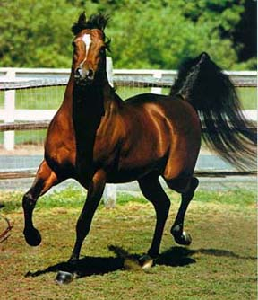
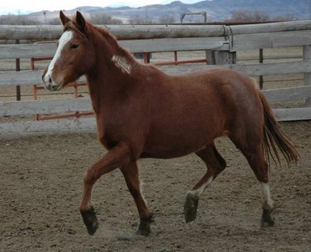
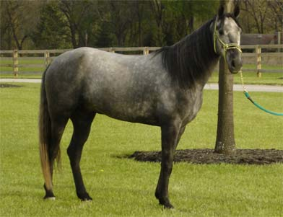
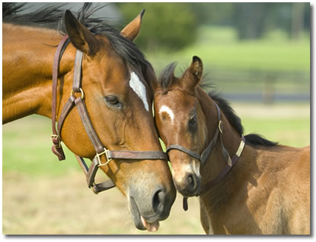
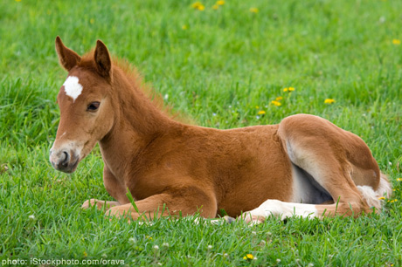
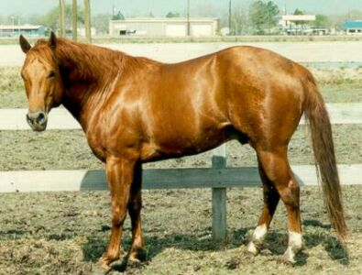
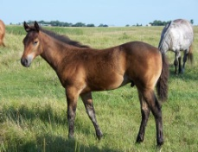
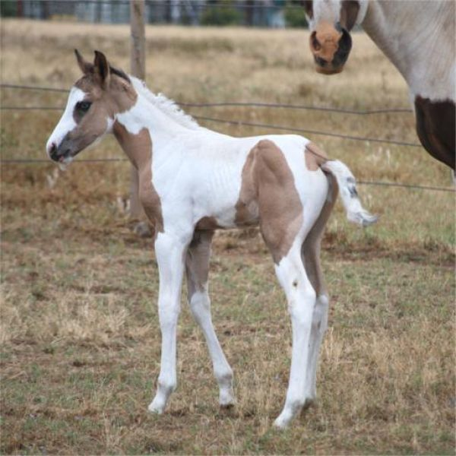
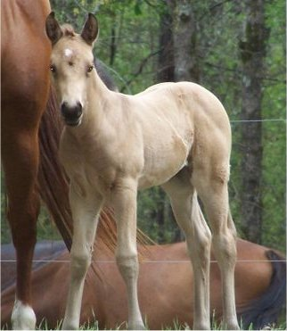
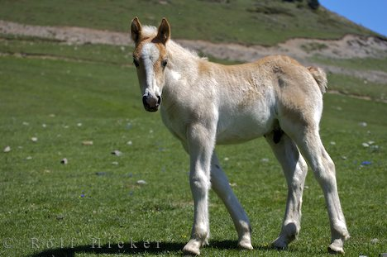
Equine

Slide 2
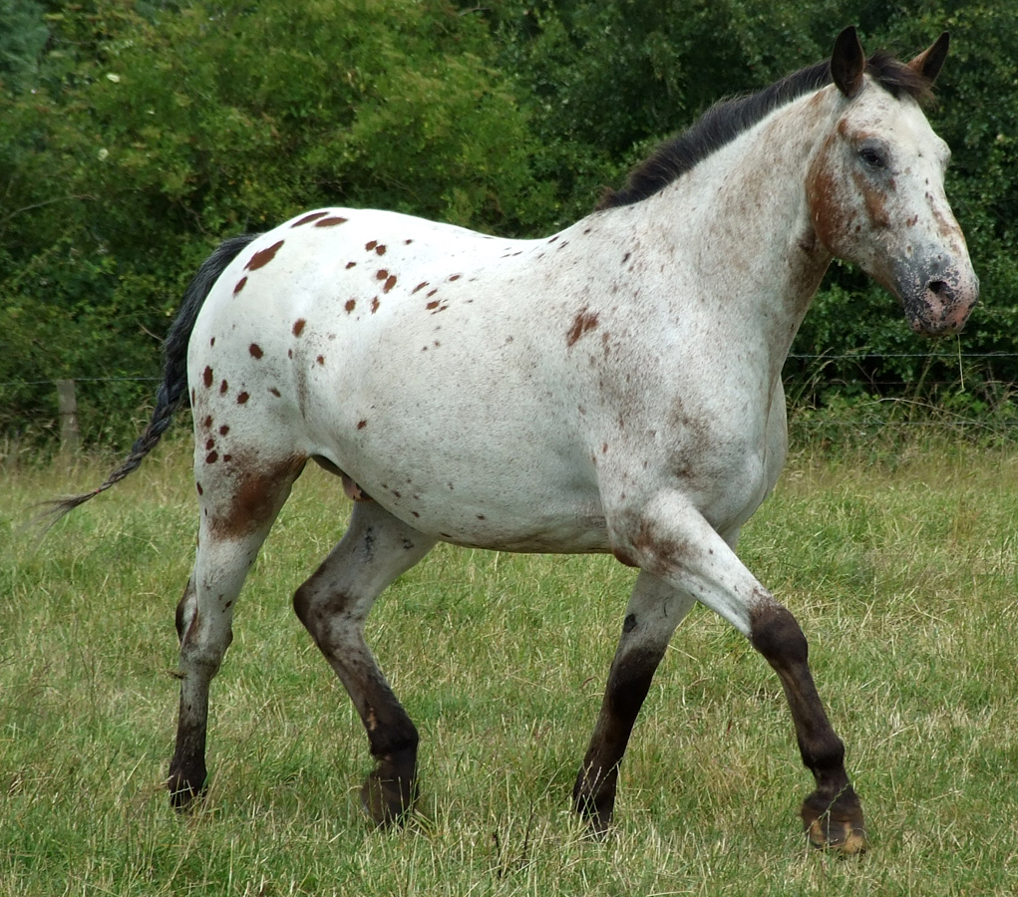
Appaloosa
Developed in the Palouse River Country of the Northwest
Three distinctive characteristics: the eye is encircled by white; the skin is mottled irregularly with black and white, particularly around muzzle; hooves are narrowly striped vertically in black and white.
General purpose riding horse

Slide 3
Arabian
From Arabia
Unsurpassed reputation for endurance
Solid colors are preferred: bay, brown, chestnut, gray and black

Slide 4
Belgian
From Belgium
Predominant color is light sorrel with flaxen mane and tail.
Easy to handle and very strong but less leg action than other breeds

Slide 5
Clydesdale
From Scotland
Extensive white face and leg markings together with the “feathering” on the lower legs are very distinctive and create a bell bottomed effect.
Lighter weight than the Percherons and Belgians though just as tall.

Slide 6
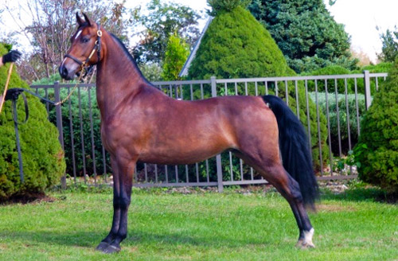
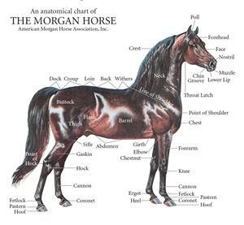
Morgan

Slide 7
Paint
From the United States
Original registry established in 1963 for Quarter Horse with too much white
Two basic color patterns: tobiano and overo

Slide 8
Percheron
Originated in Northwestern France
The oldest equine breed
Most popular draft breed in the early 1900s
16.1 to 16.3 hands tall
1,900 to 2,100 pounds
Black or gray in color

Slide 9
Quarter Horse
From United States
Developed as a saddle horse with great speed over short distances
The working cow horse of the ranches of the Southwest and West.

Slide 10
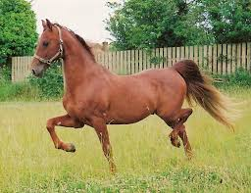
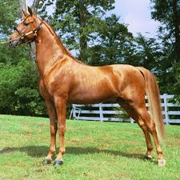
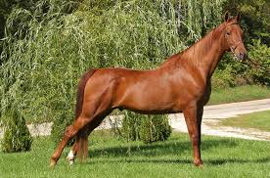
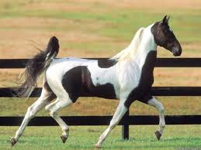
Saddlebred

Slide 11
Tennessee Walking Horse
From Tennessee
General purpose horse for riding, driving and farm work
Capable of naturally over striding

Slide 12
Thoroughbred
From England
Ideal Thoroughbred can not be described, “they run in all shapes and sizes”
Famous stallions include Secretariat, Northern Dancer and Bold Ruler

